Slide 1
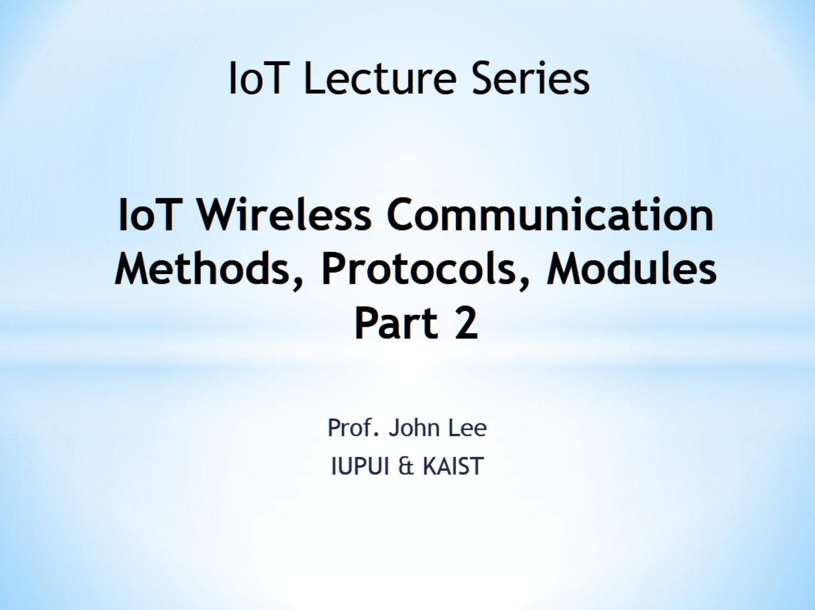
IoT Wireless Communication Methods, Protocols, Modules Part 2

Slide 2
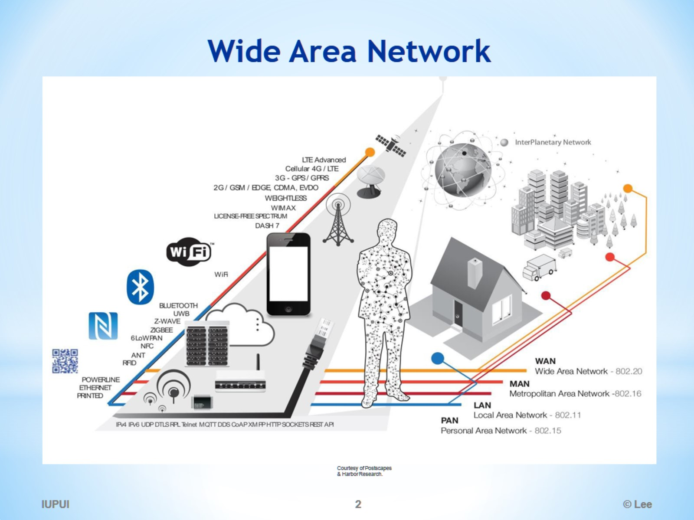
Wide Area Network

Slide 3
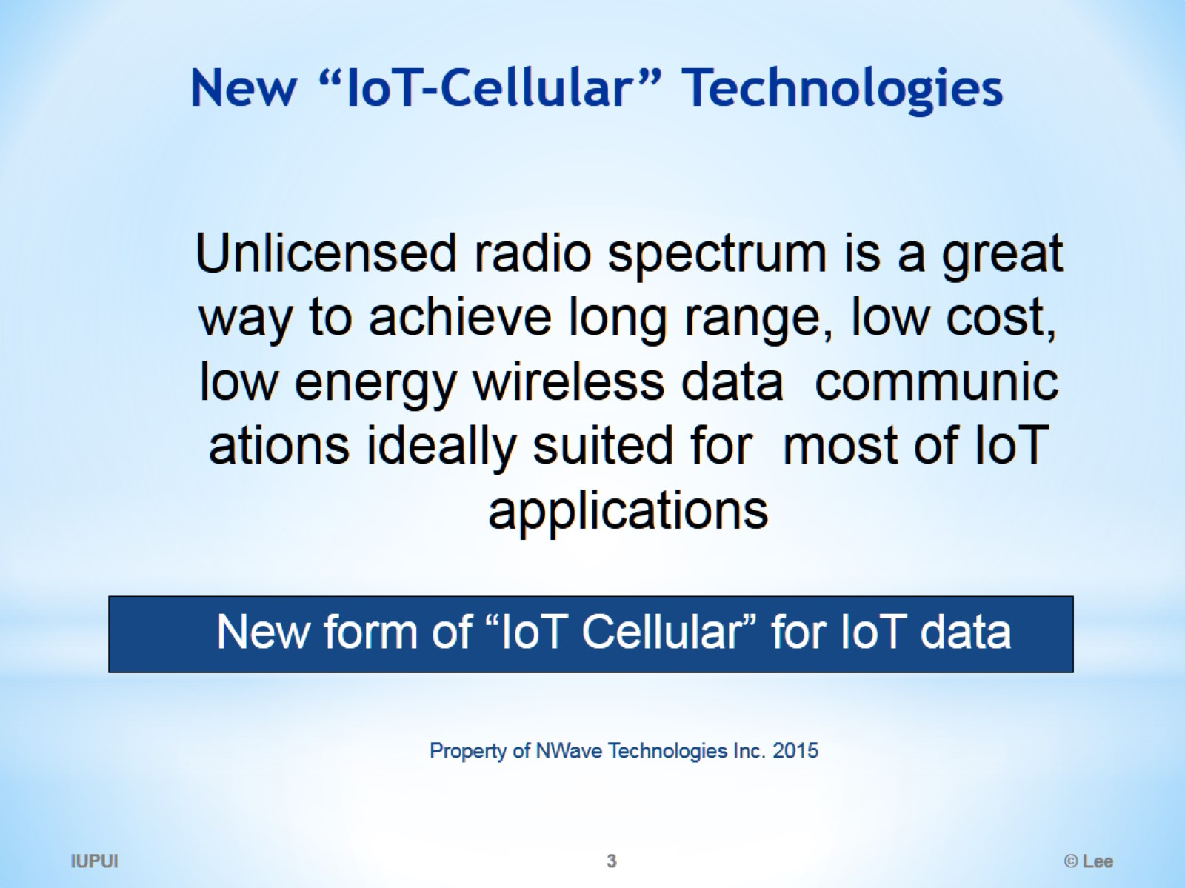
New “IoT‐Cellular” Technologies

Slide 4
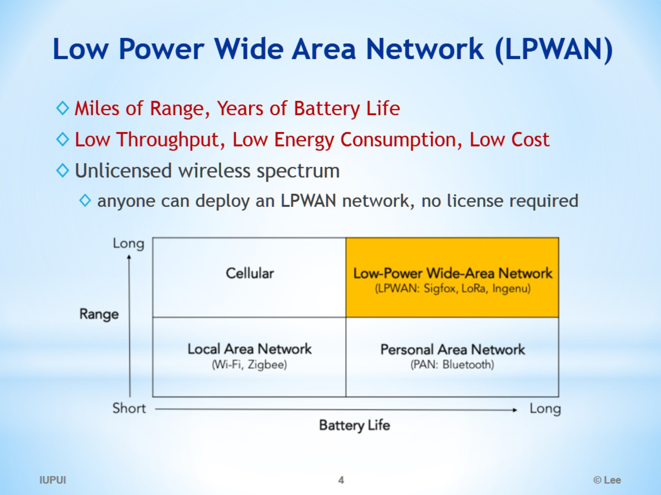
Low Power Wide Area Network (LPWAN)

Slide 5
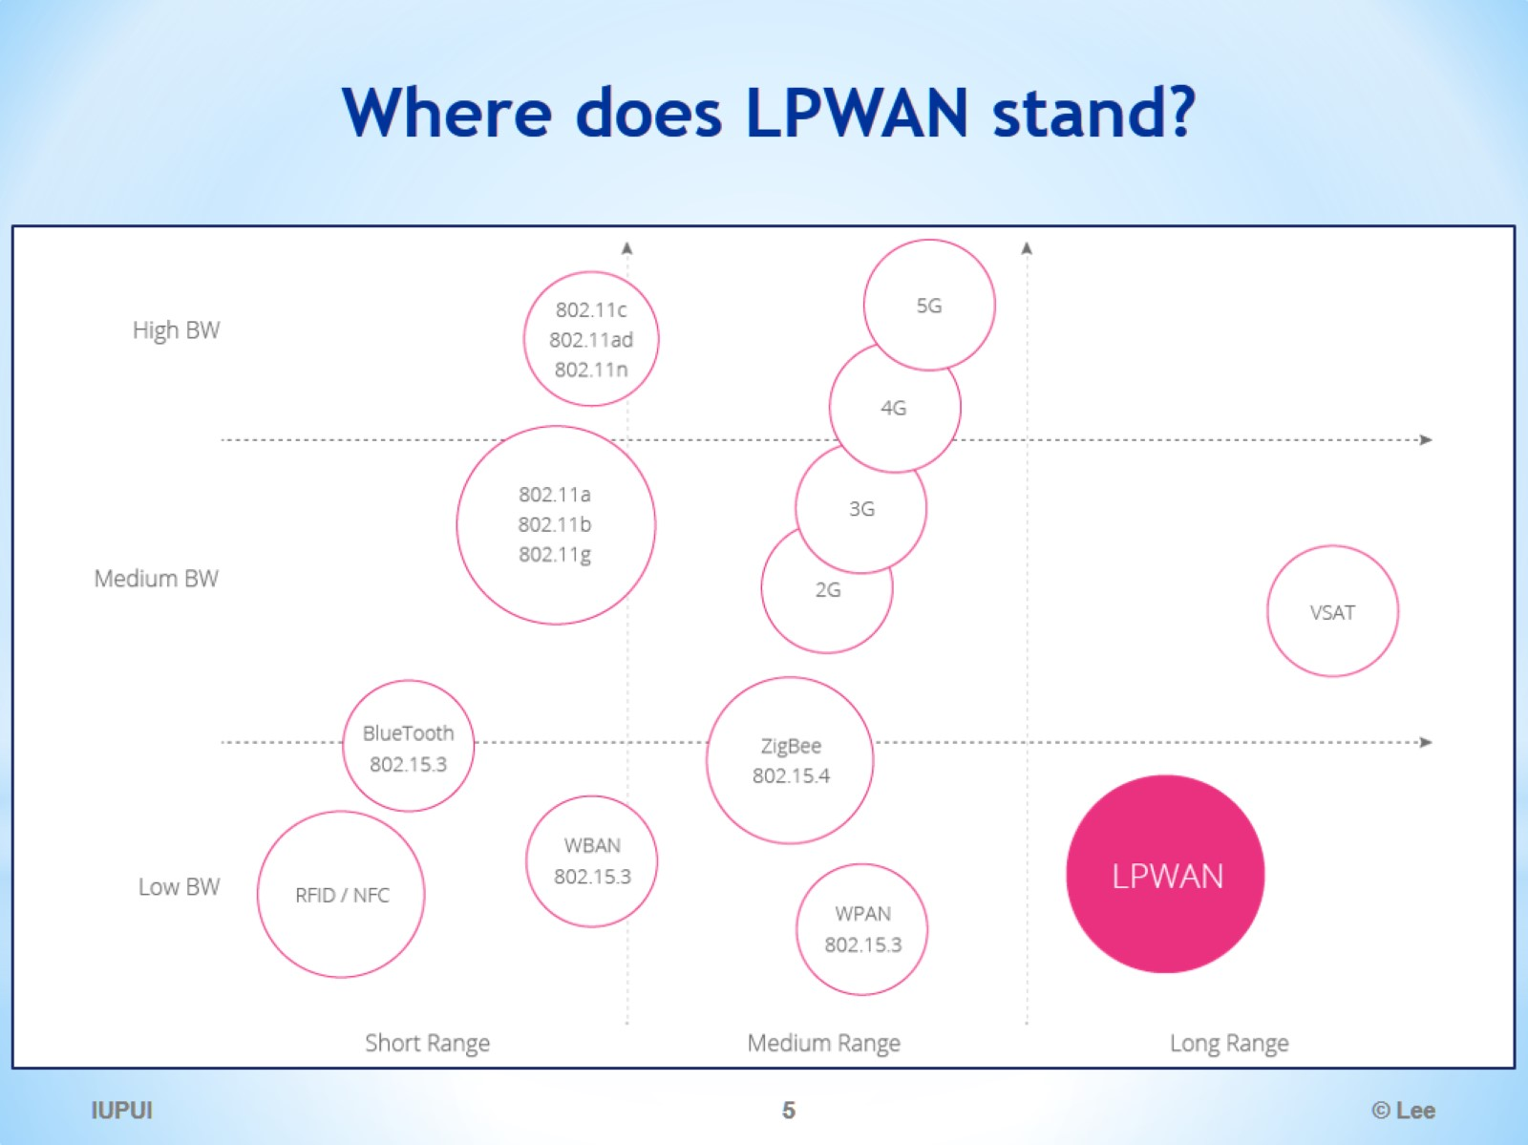
Where does LPWAN stand?

Slide 6
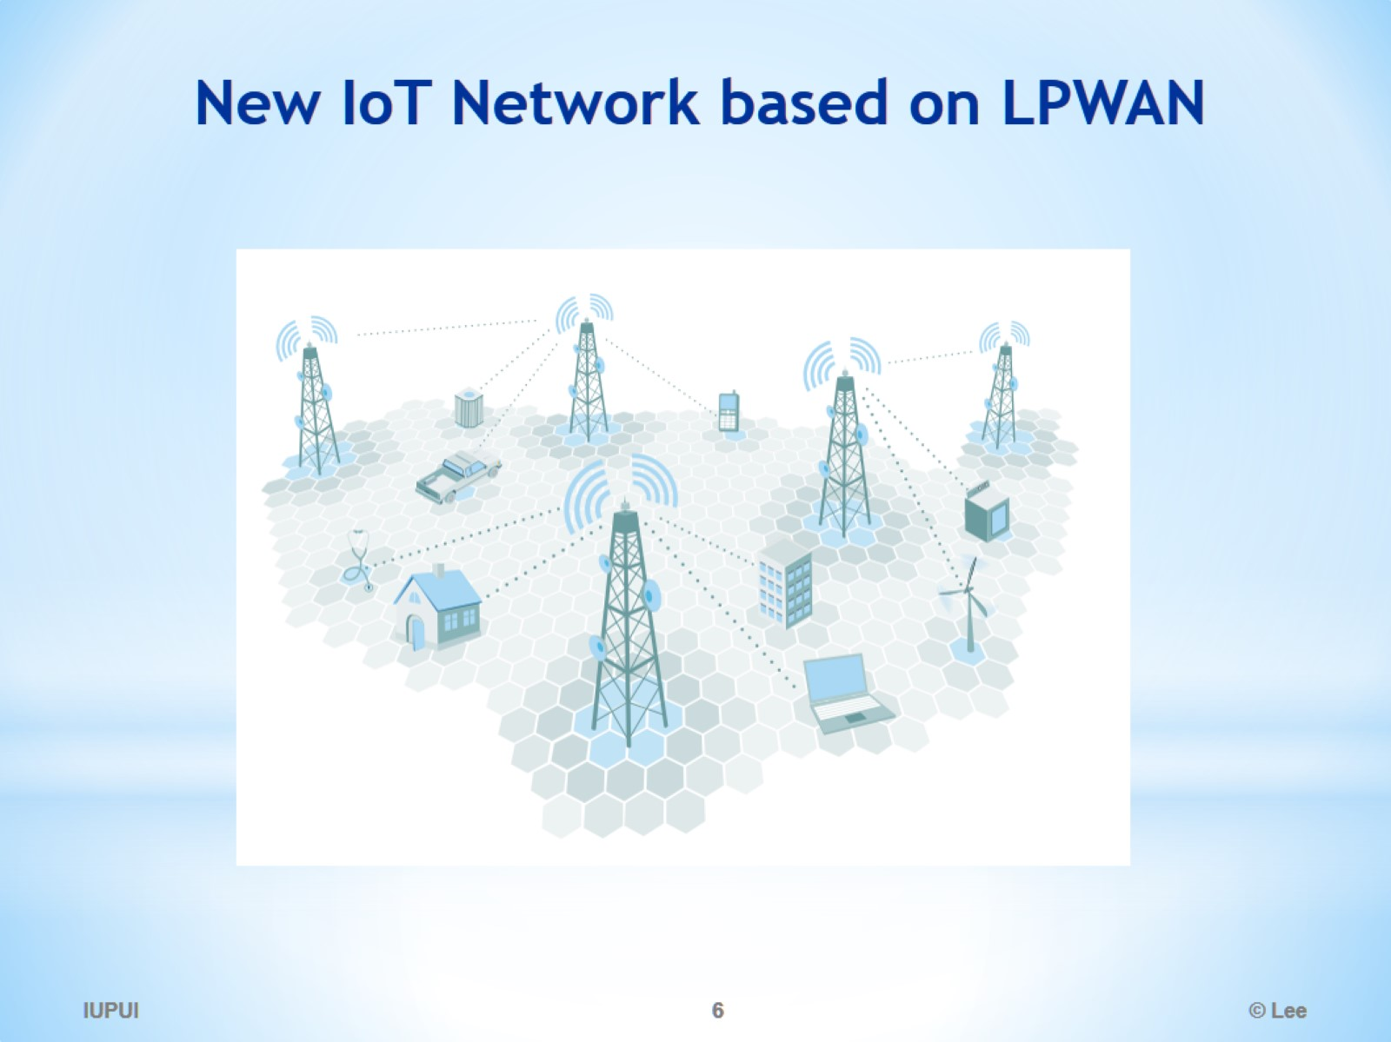
New IoT Network based on LPWAN

Slide 7
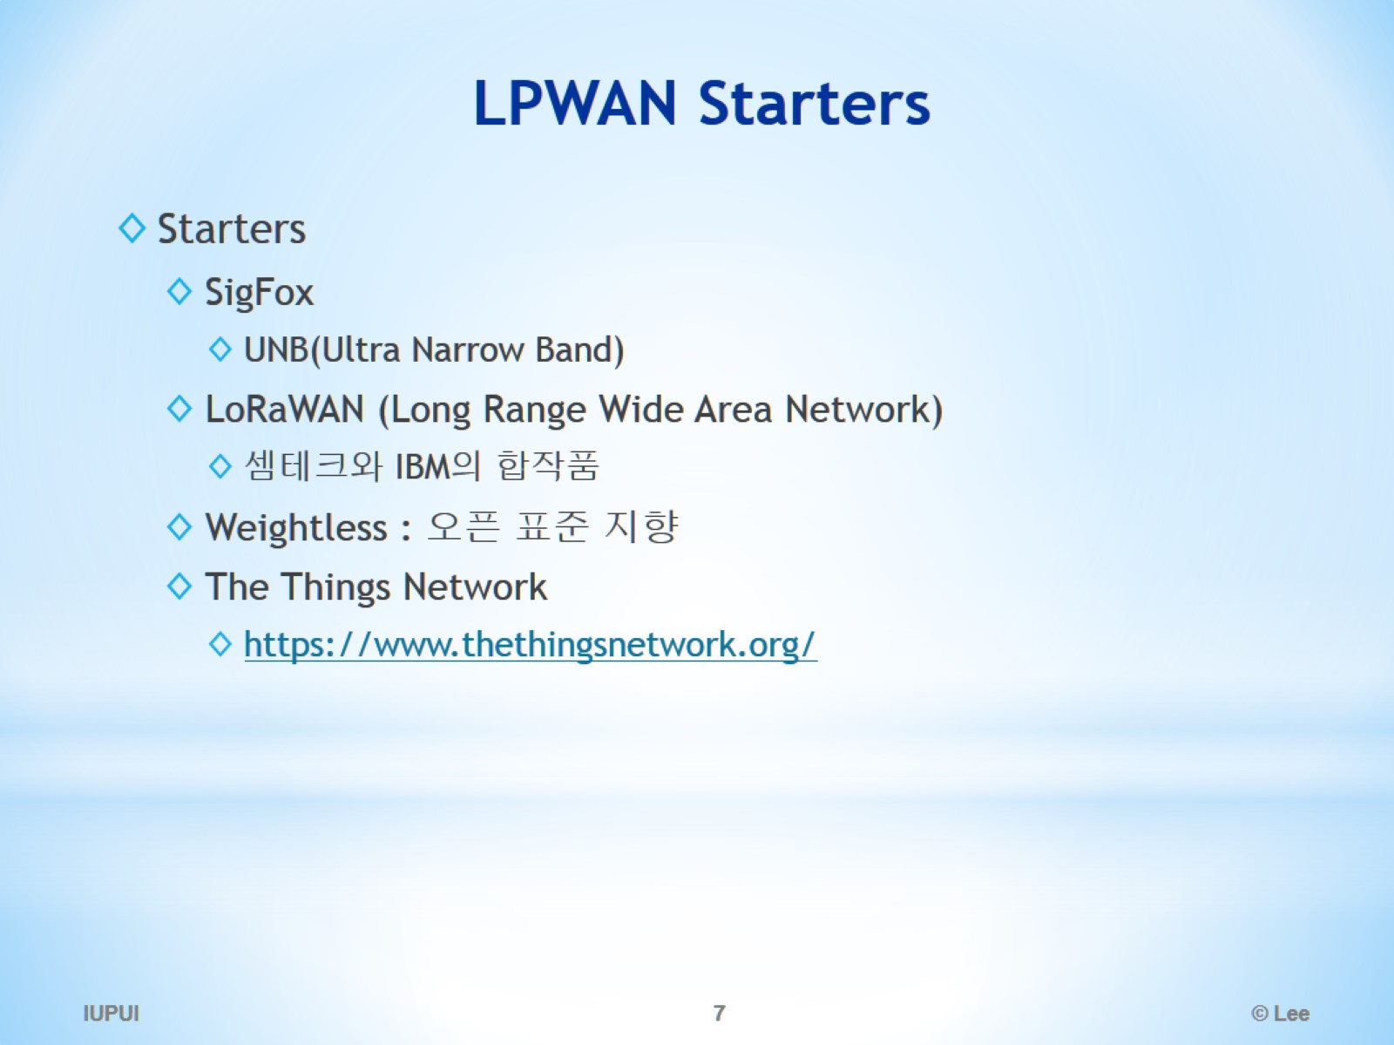
LPWAN Starters

Slide 8
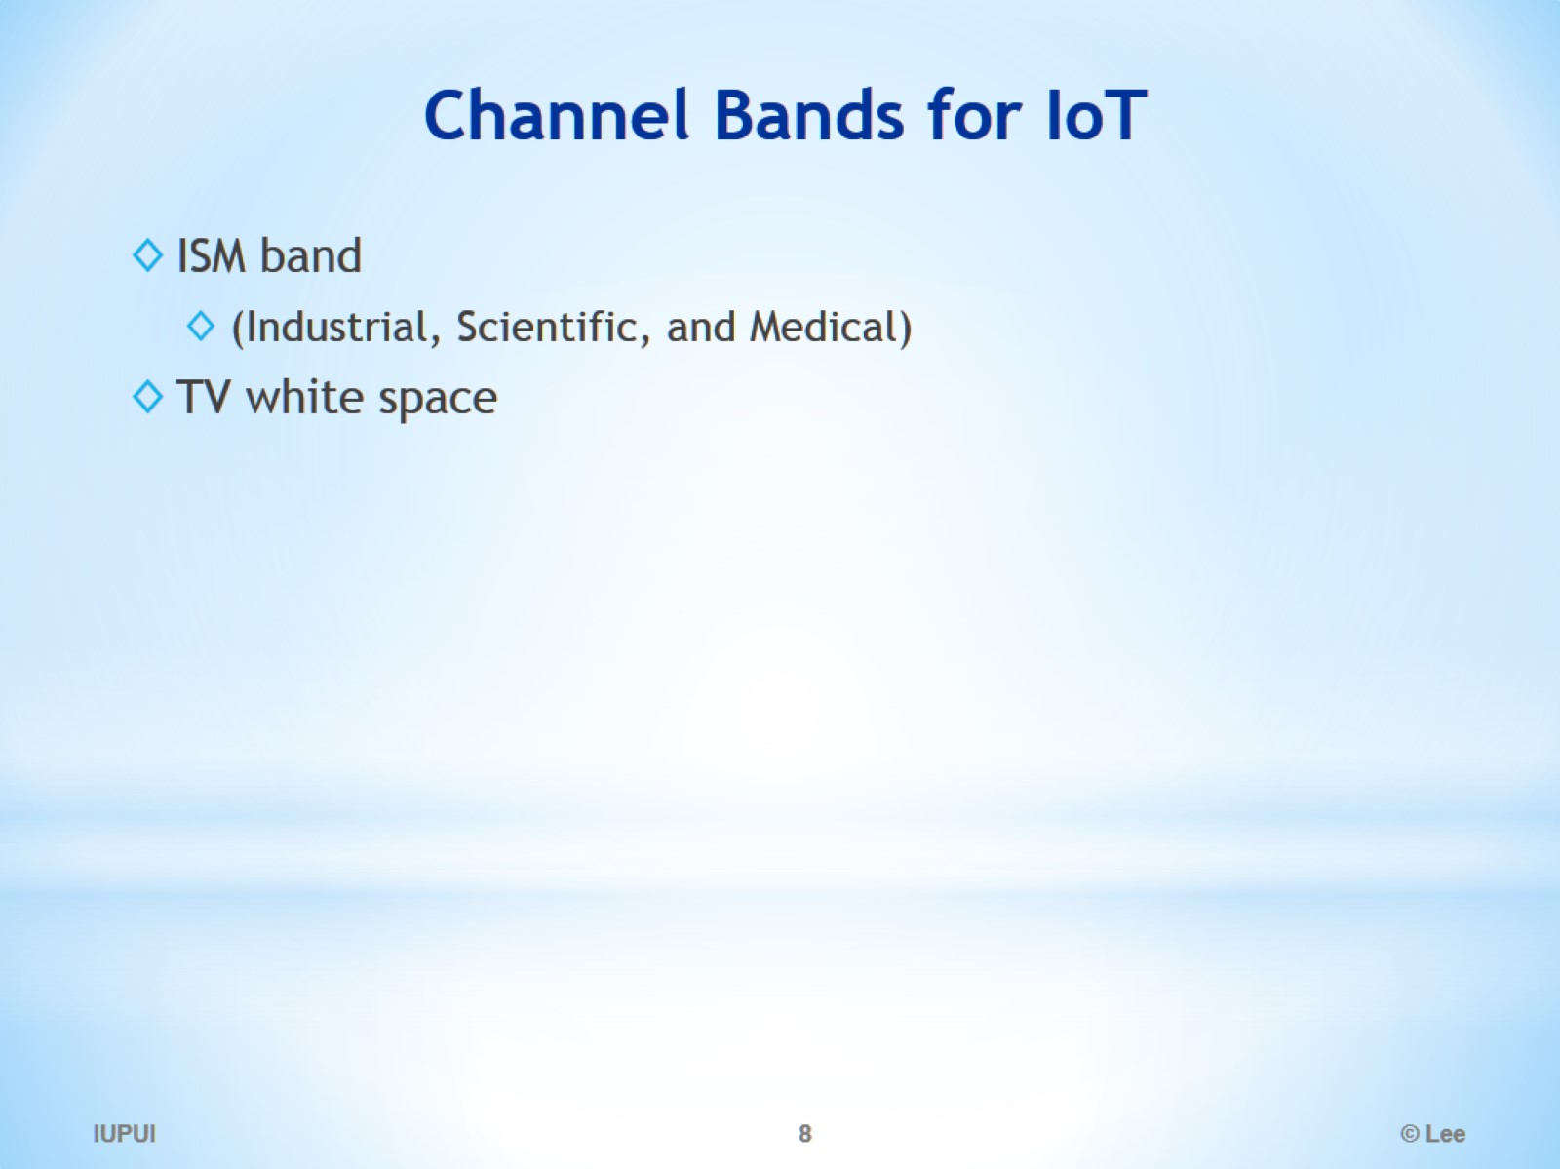
Channel Bands for IoT

Slide 9
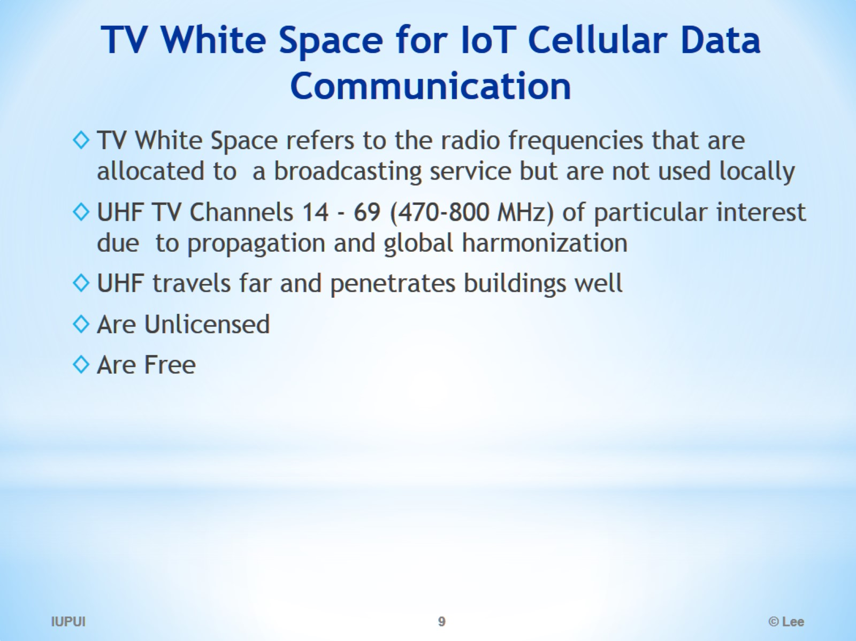
TV White Space for IoT Cellular Data Communication

Slide 10
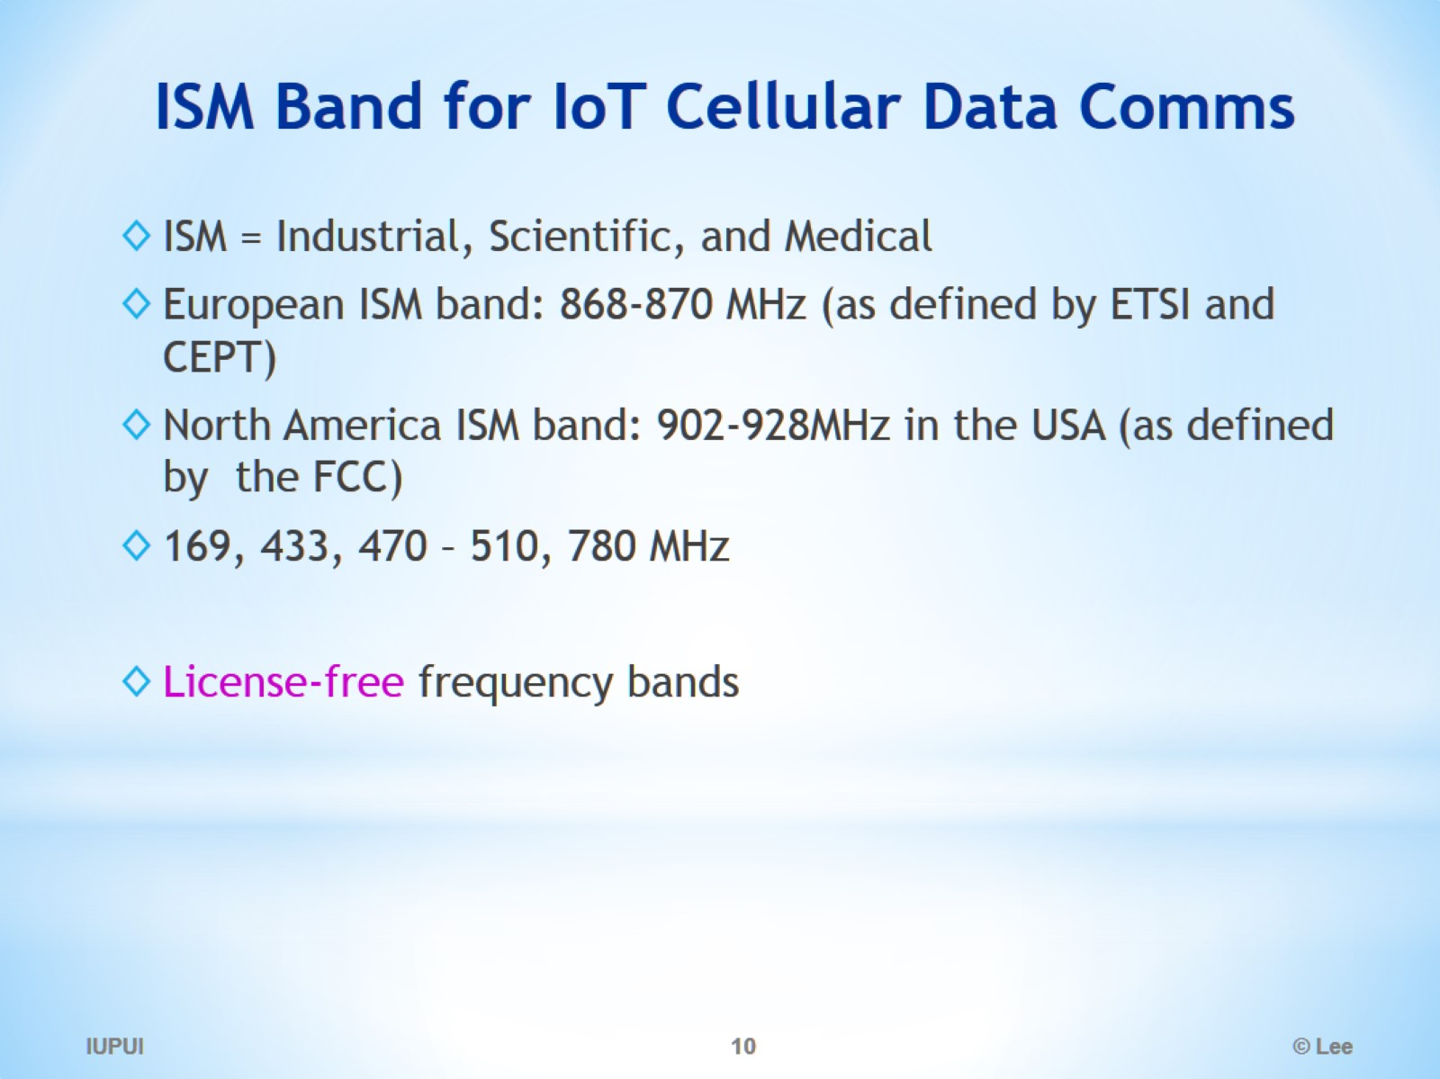
ISM Band for IoT Cellular Data Comms

Slide 11
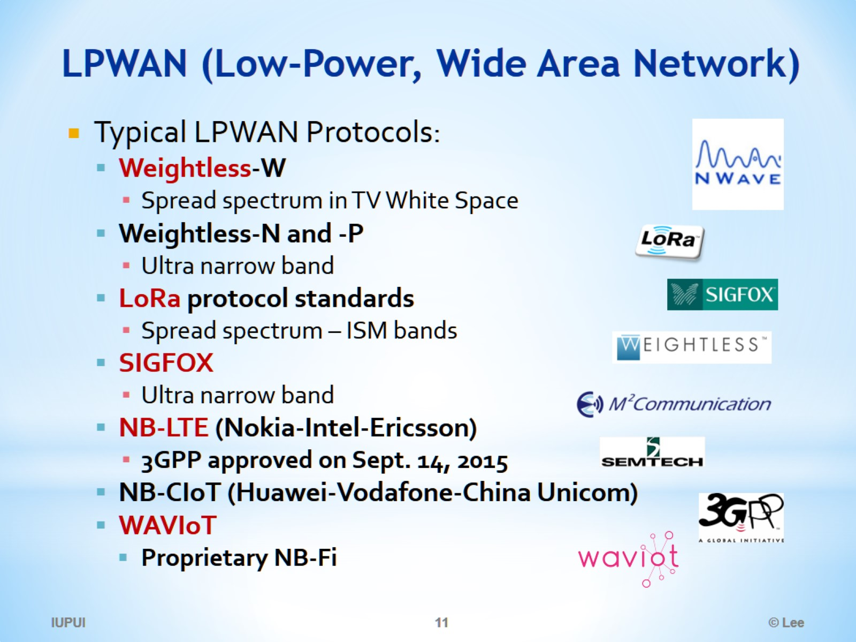
LPWAN (Low-Power, Wide Area Network)

Slide 12
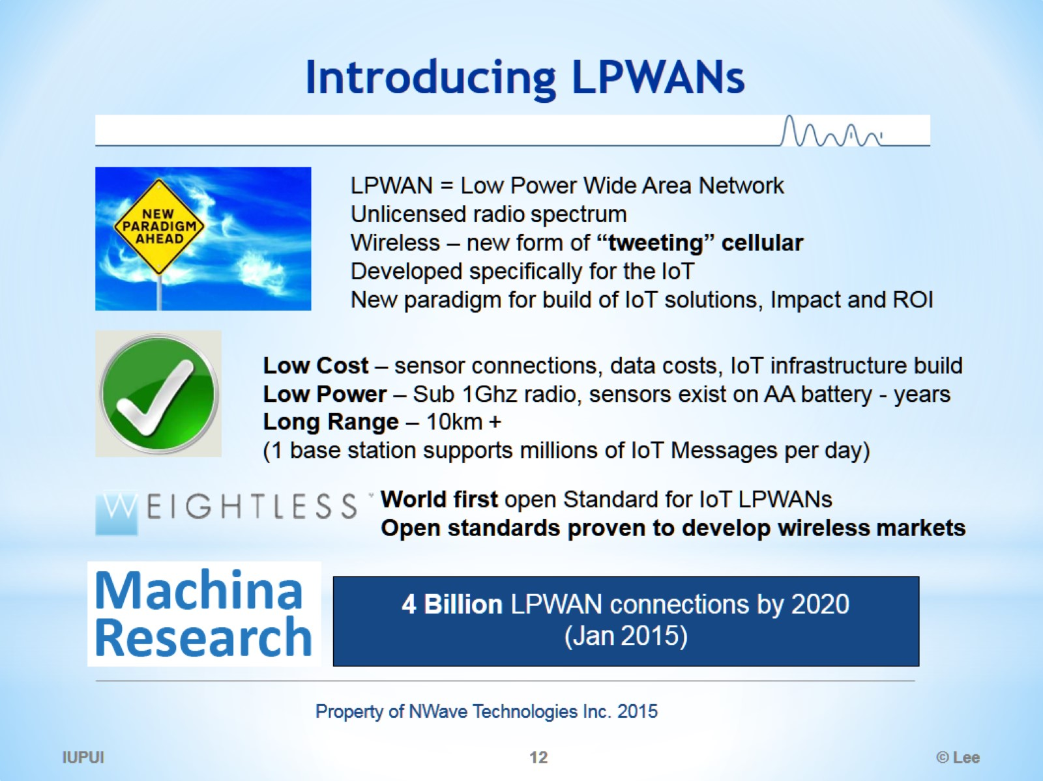
Introducing LPWANs

Slide 13
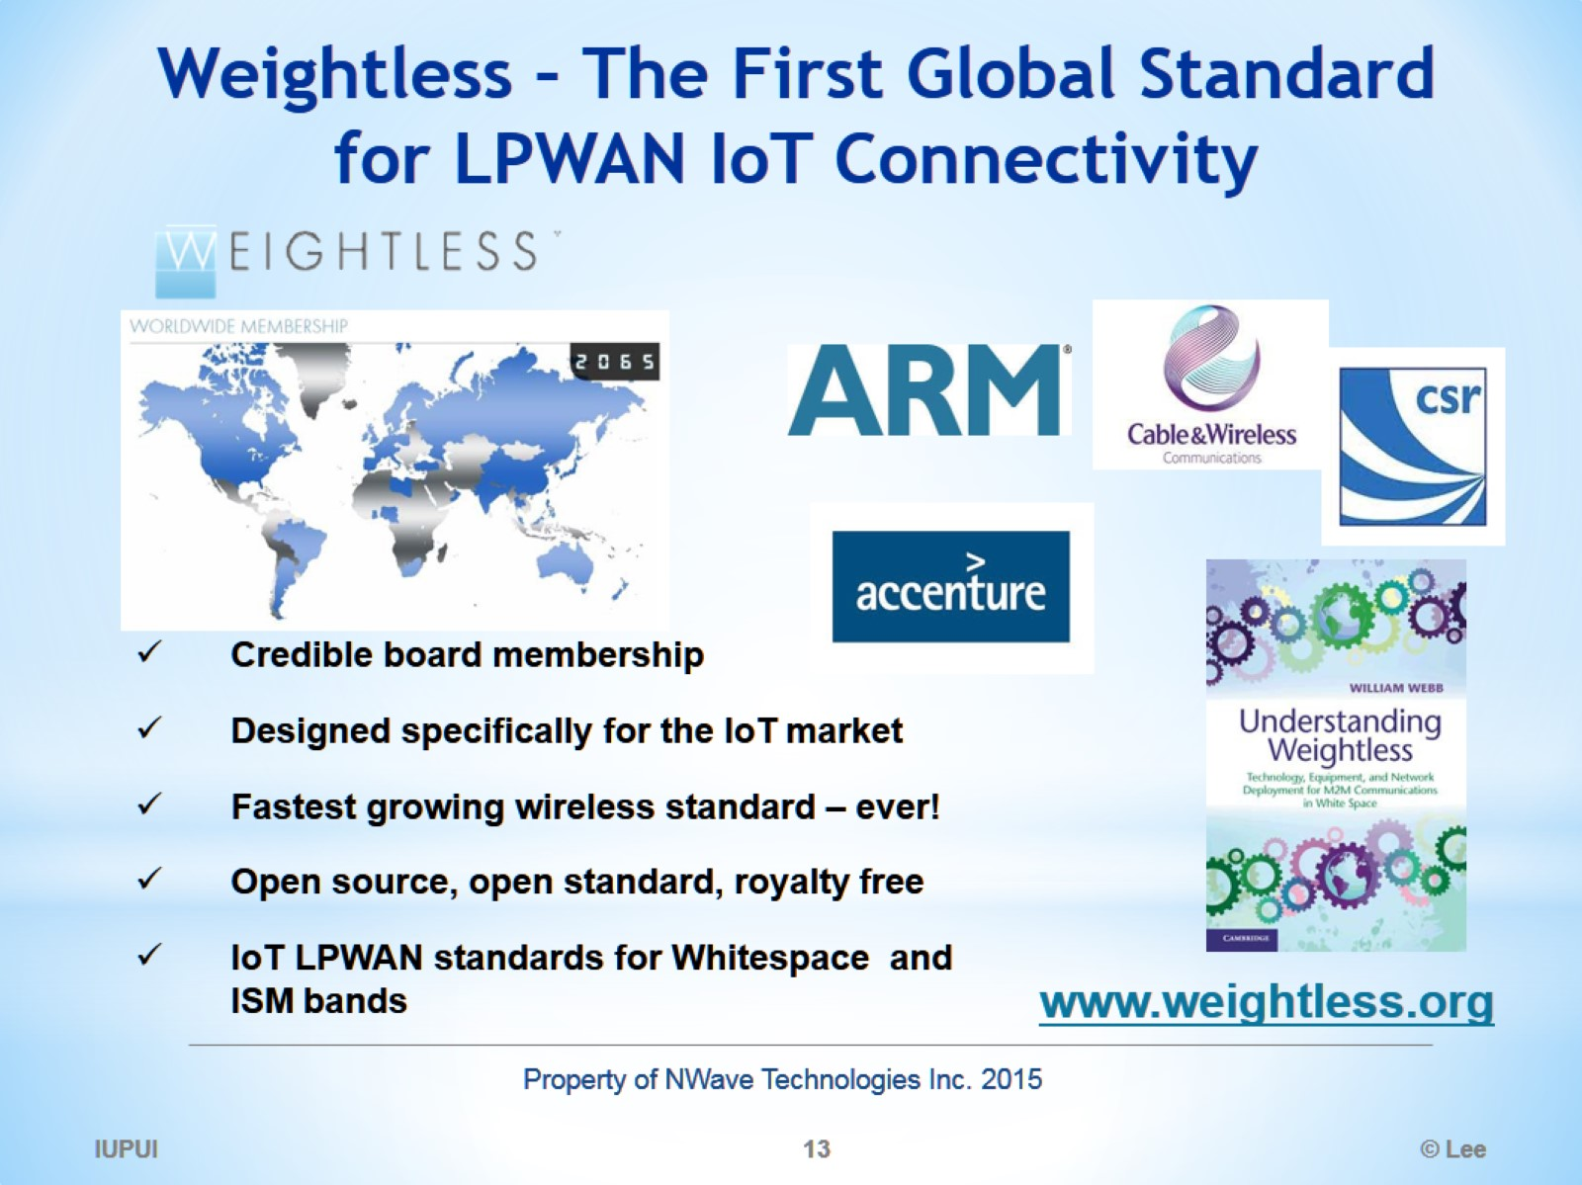
Weightless – The First Global Standard for LPWAN IoT Connectivity

Slide 14
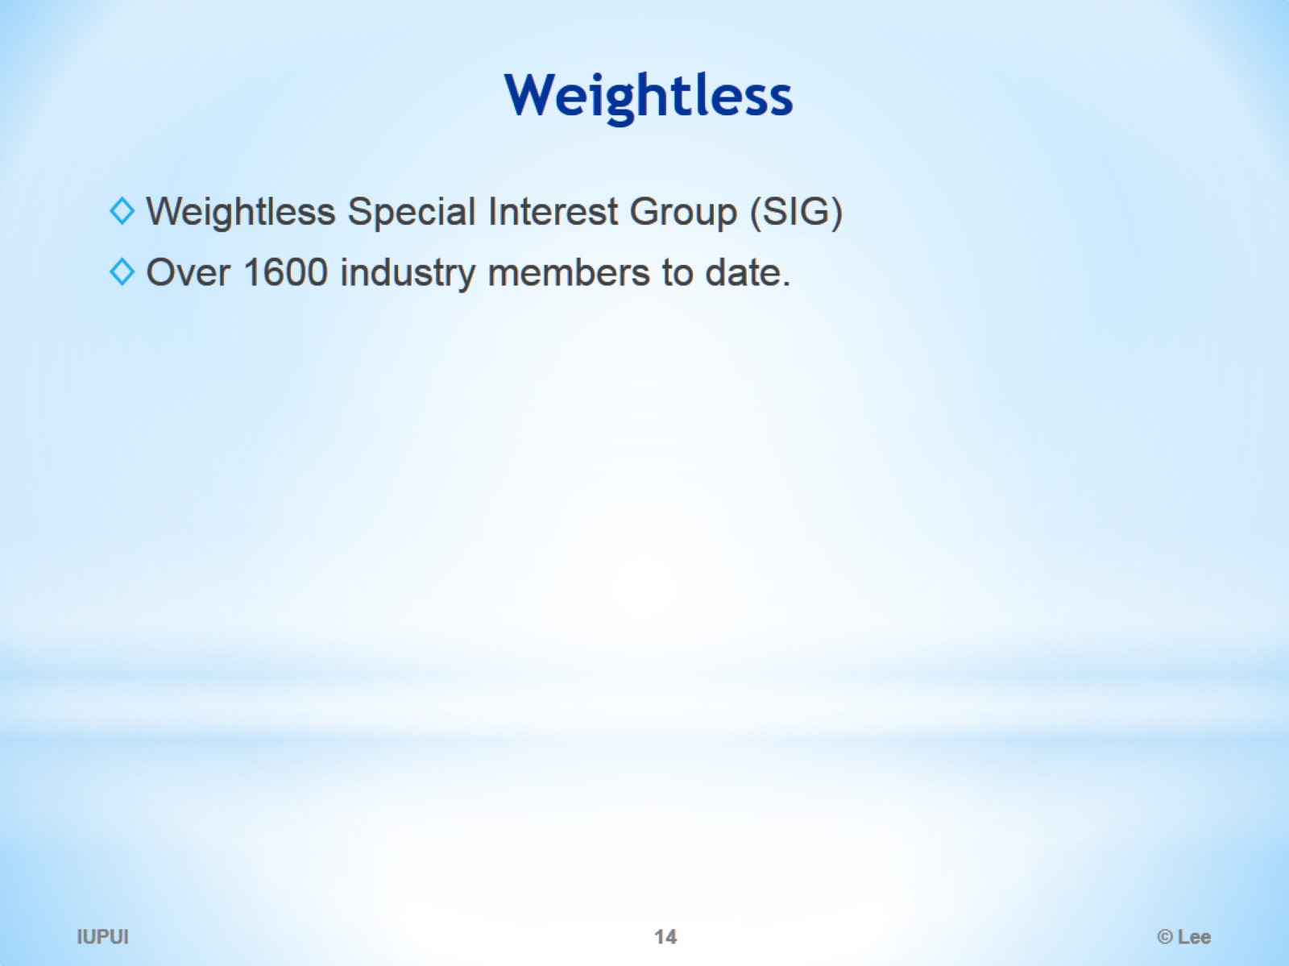
Weightless

Slide 15
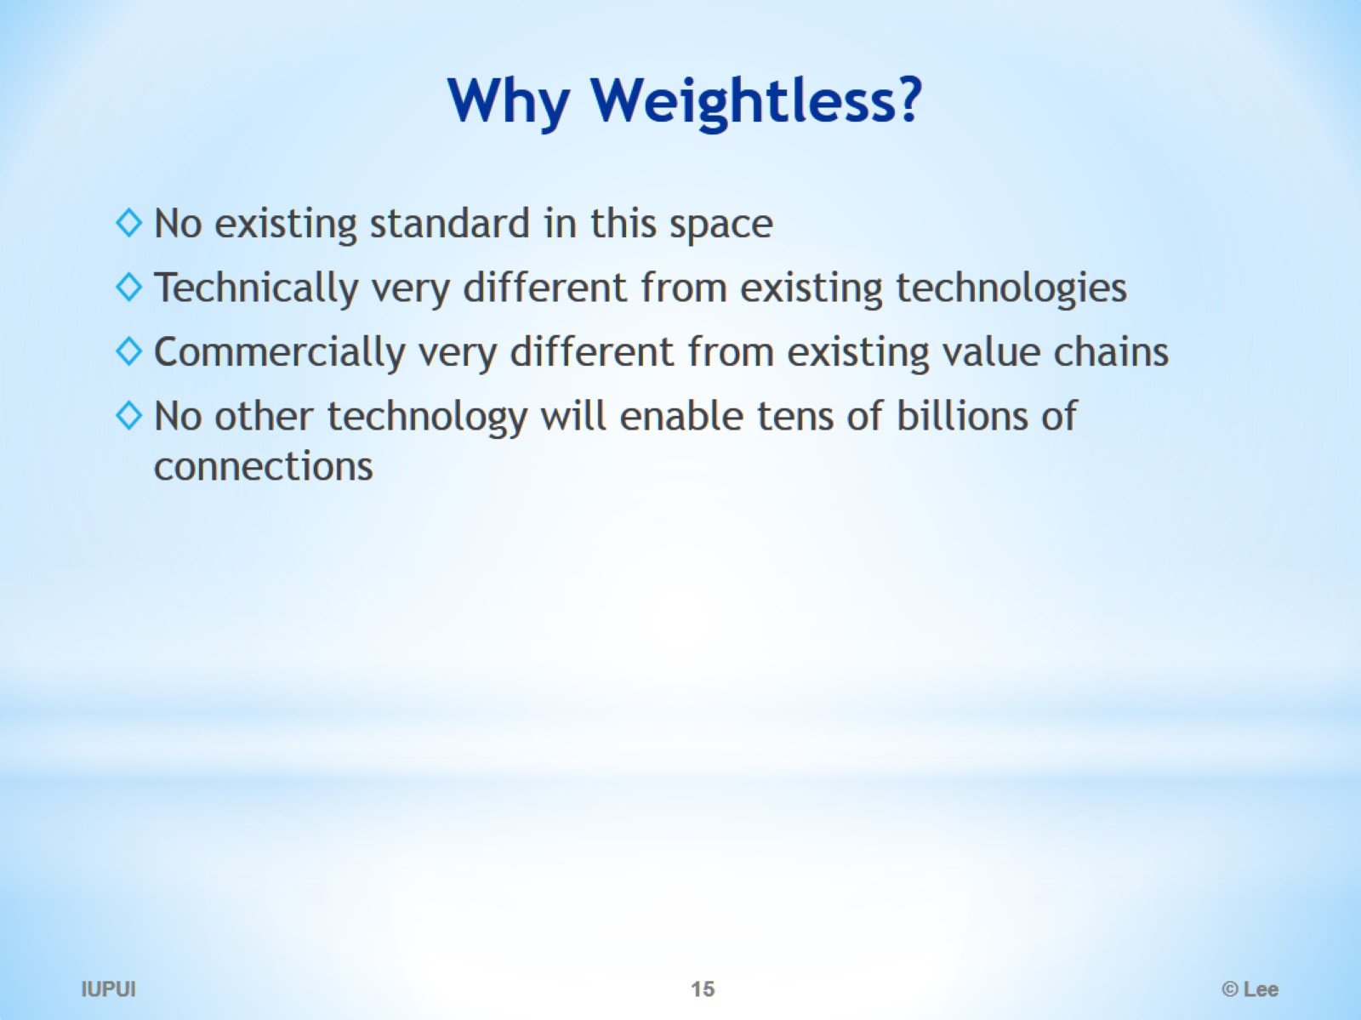
Why Weightless?

Slide 16
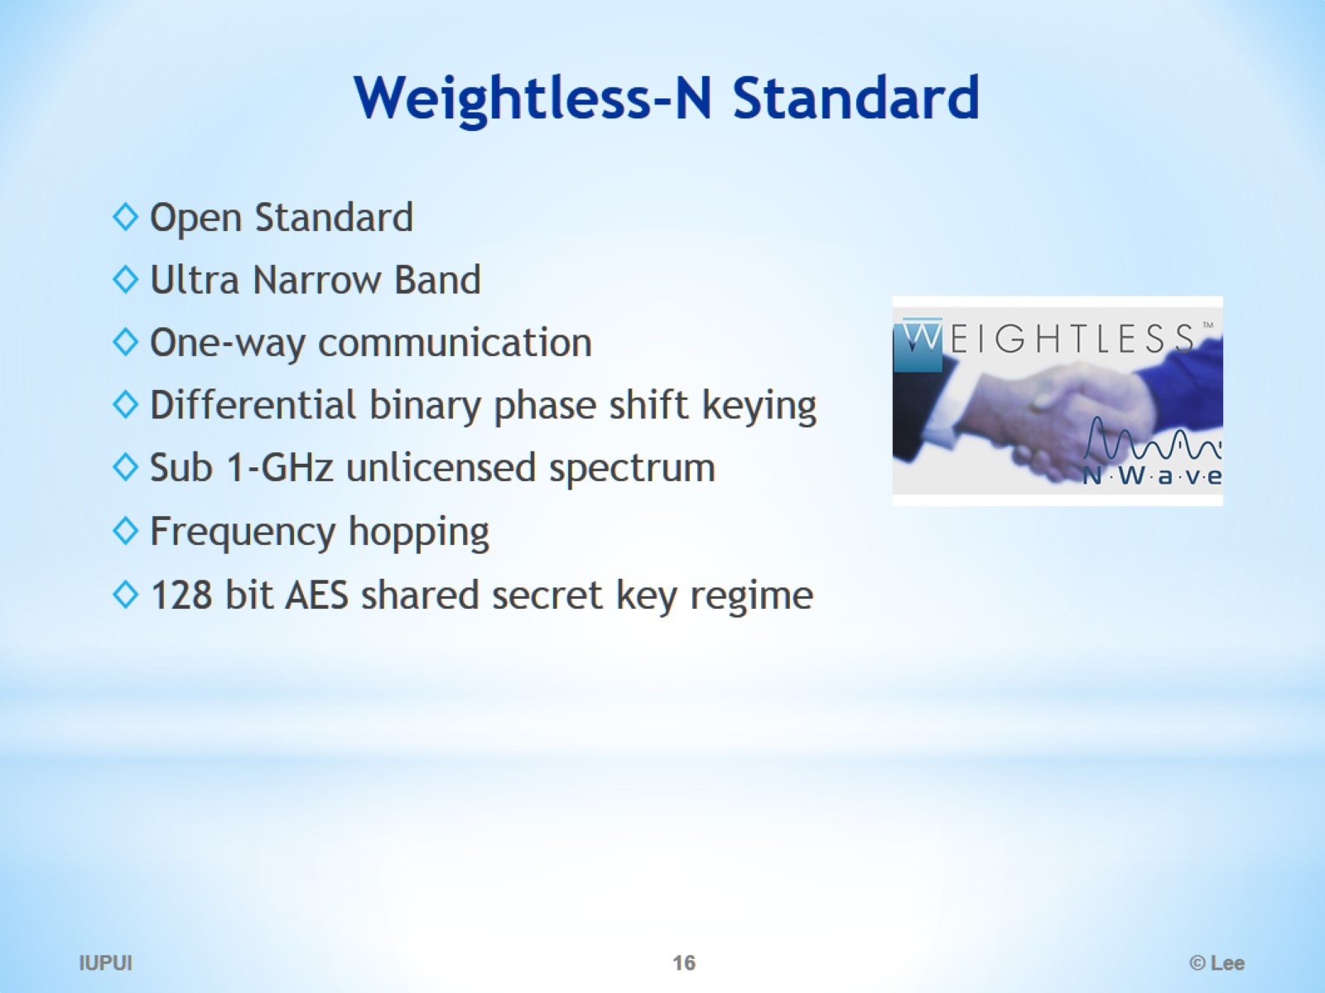
Weightless-N Standard

Slide 17
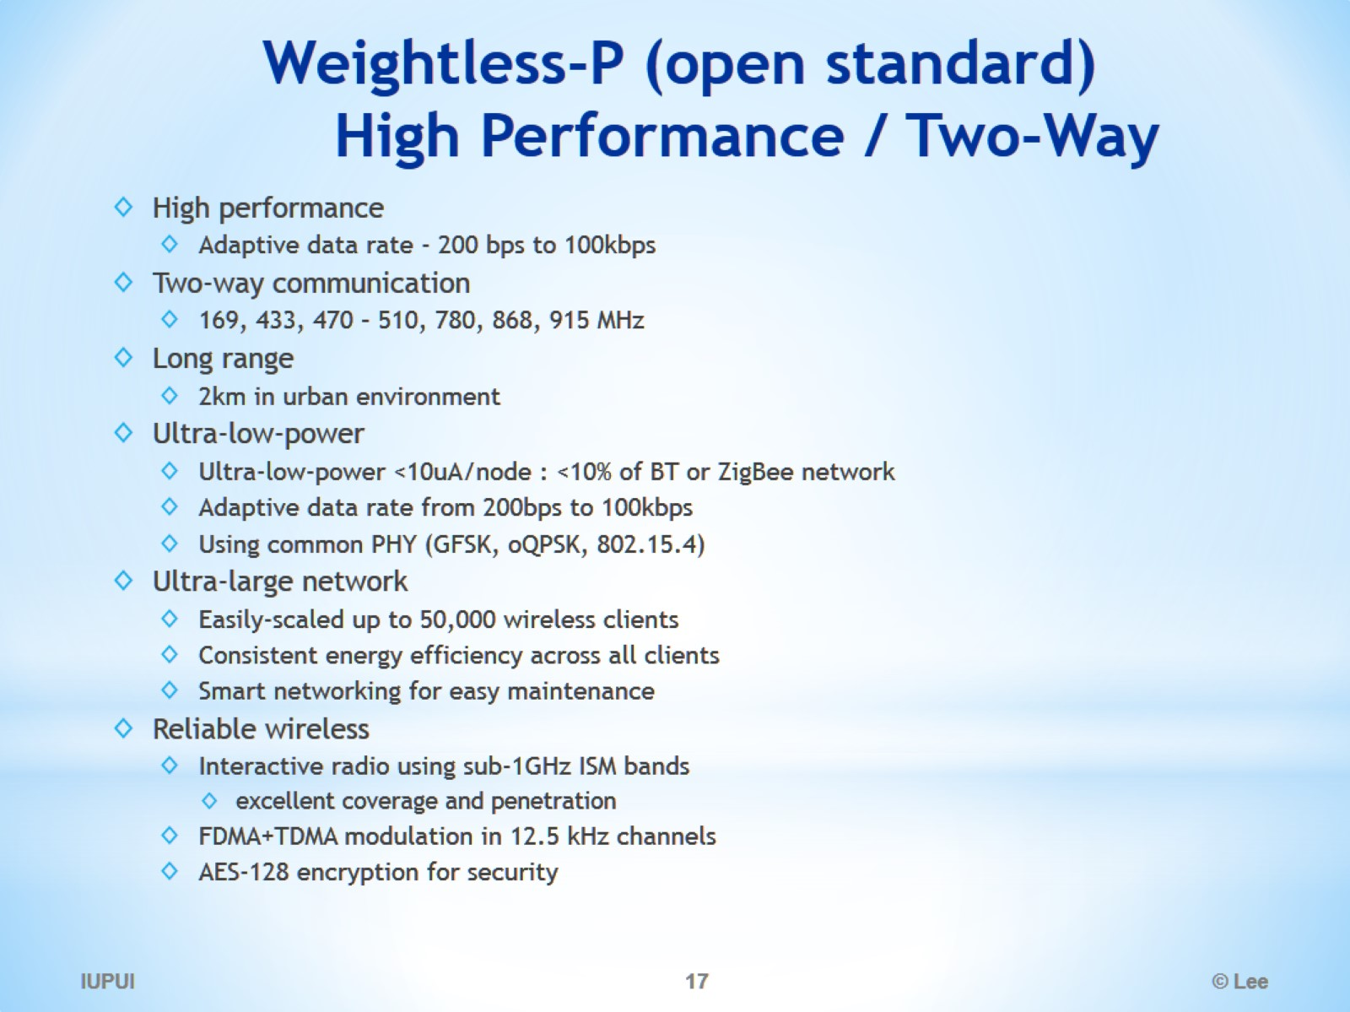
Weightless-P (open standard) High Performance / Two-Way

Slide 18
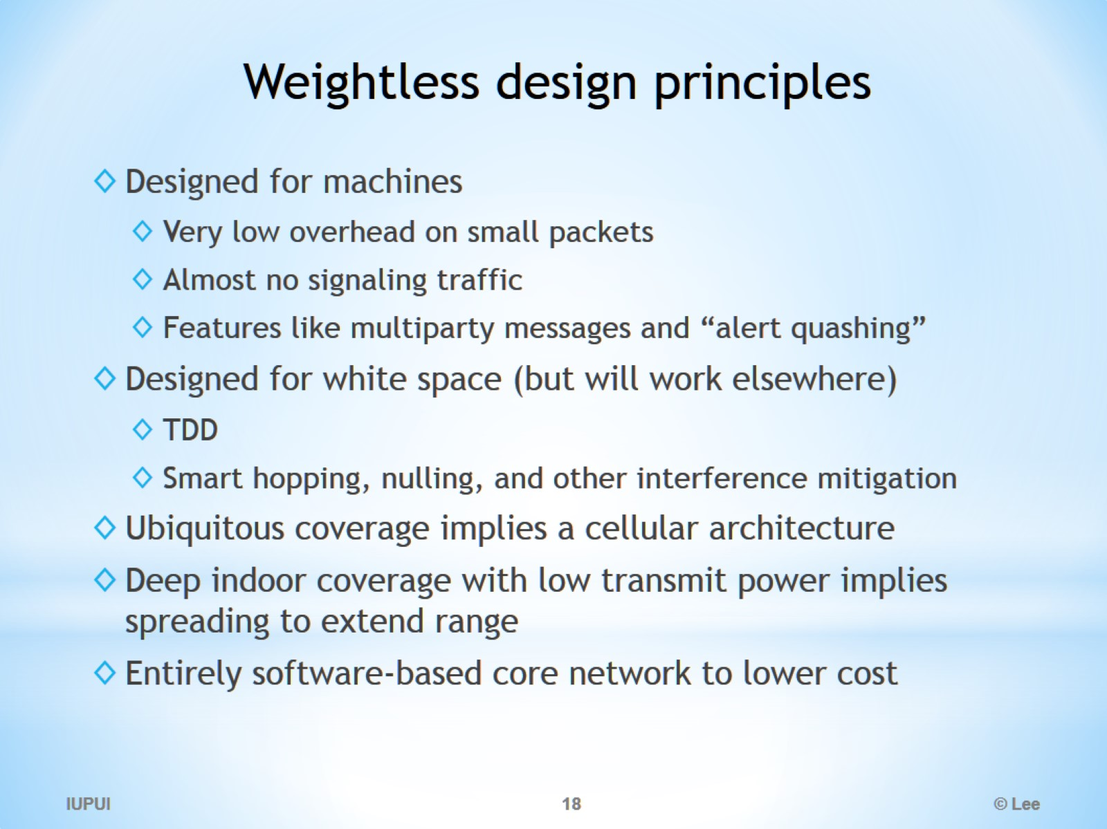
Weightless design principles

Slide 19
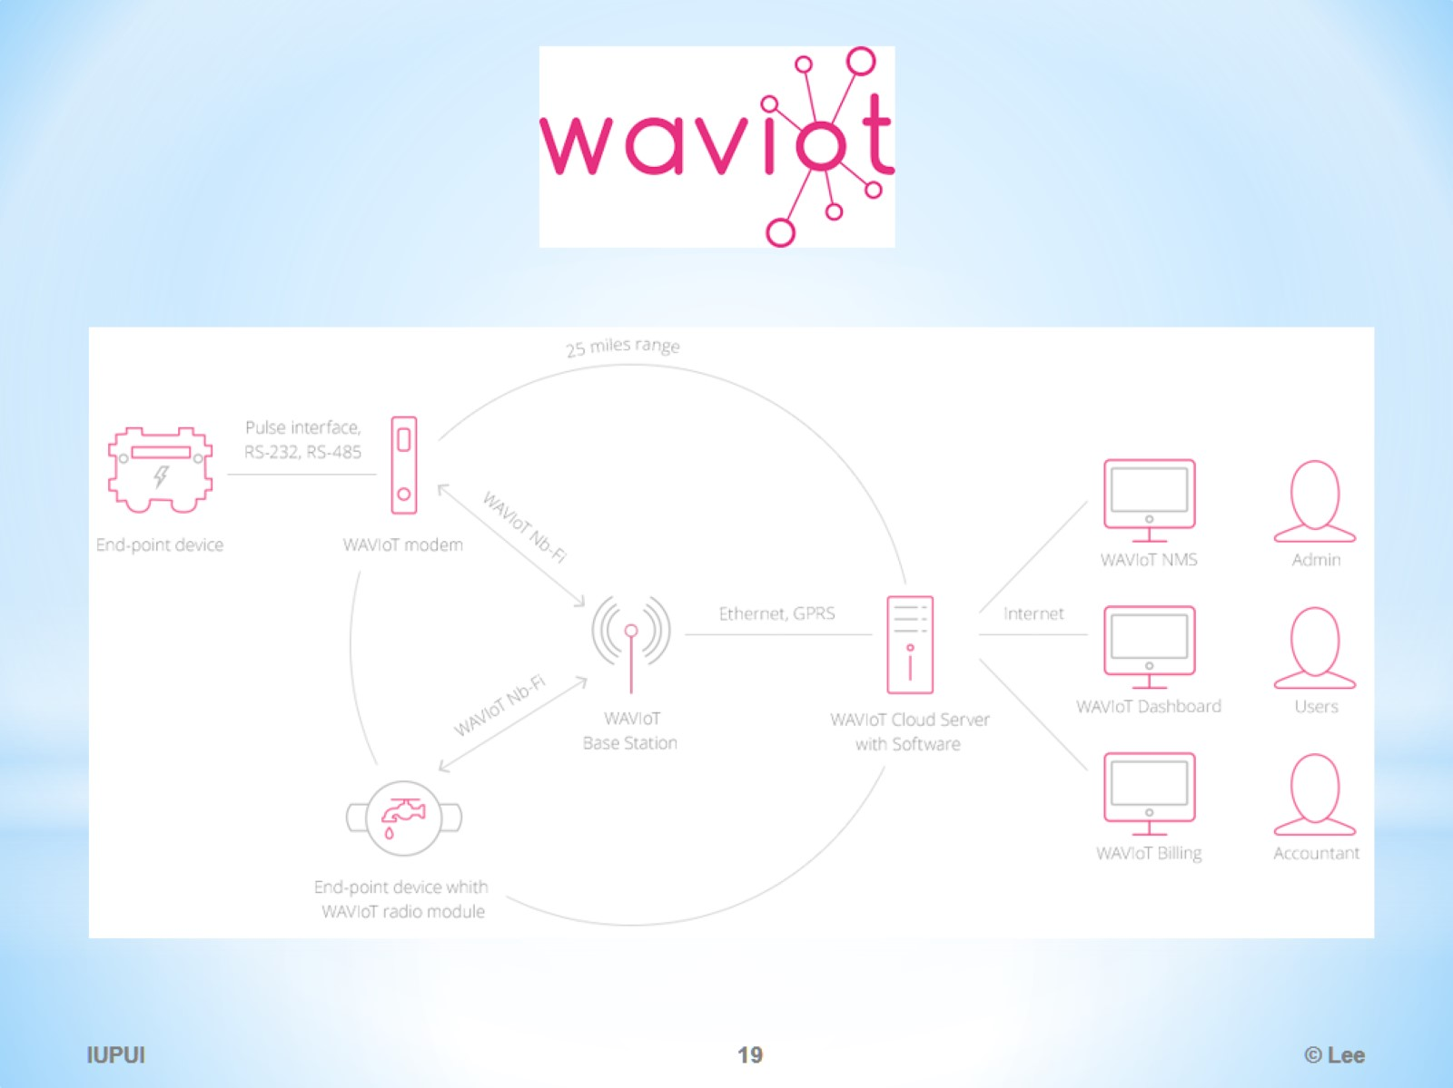

Slide 20
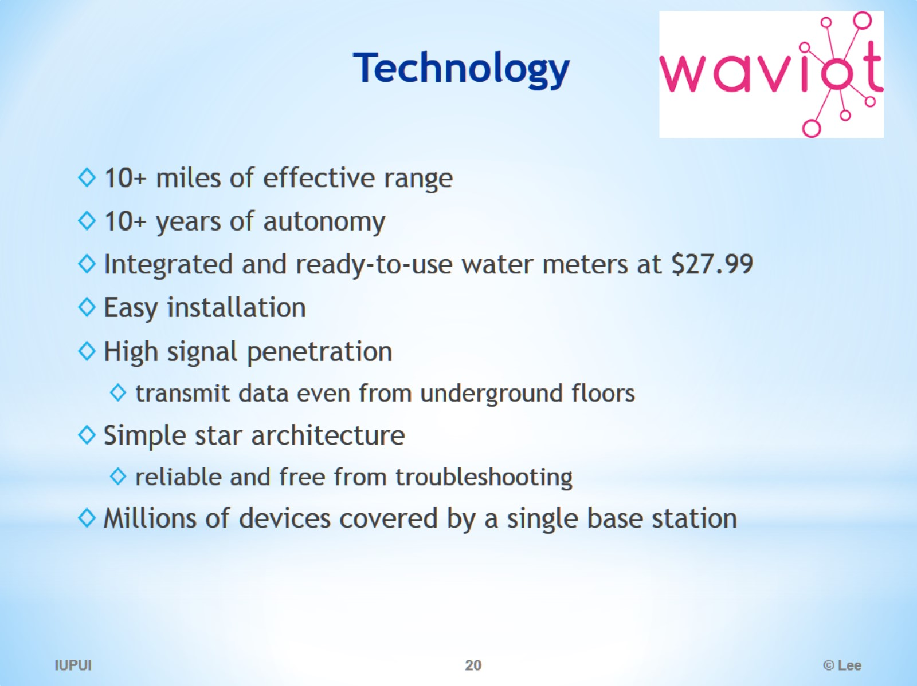
Technology

Slide 21
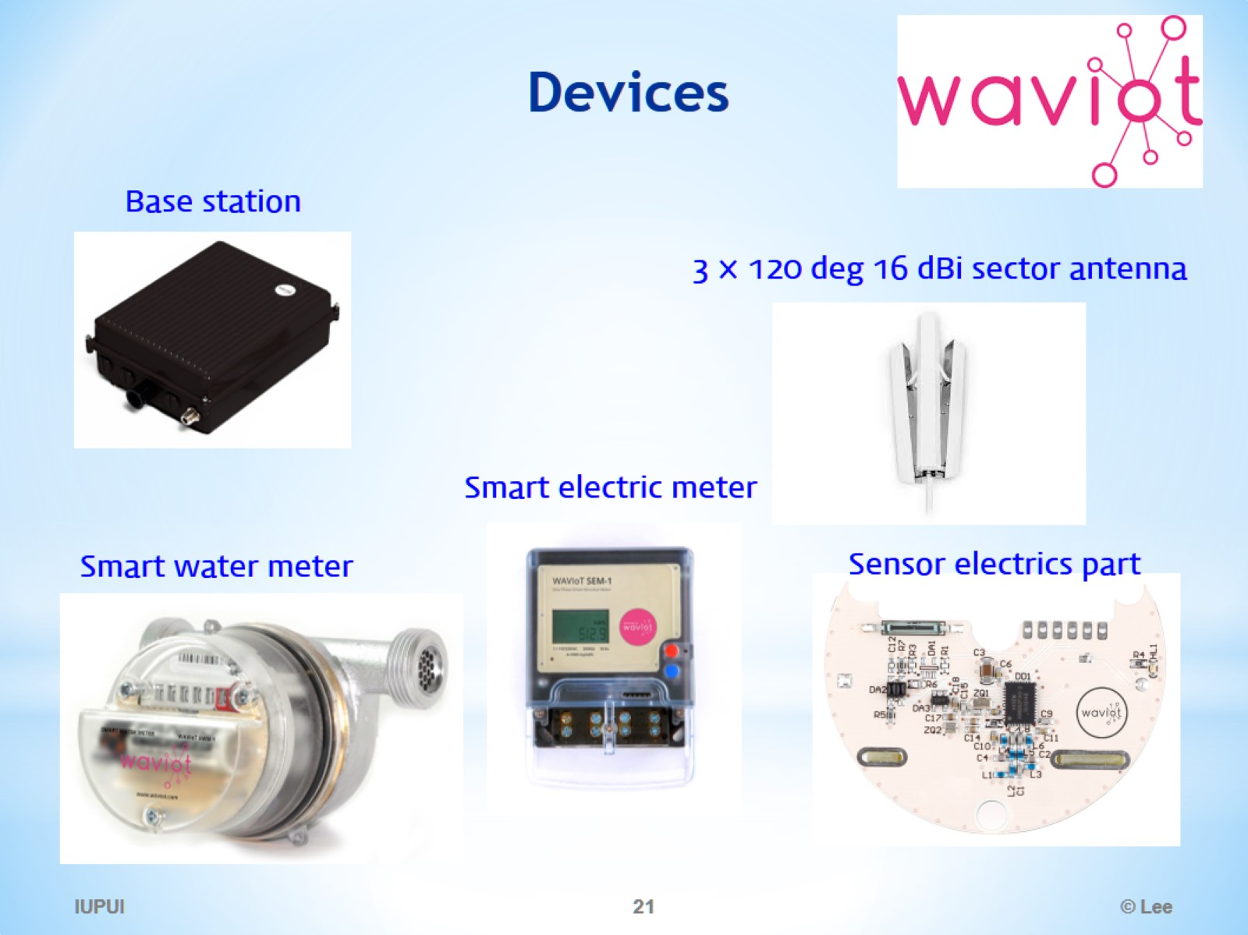
Devices

Slide 22
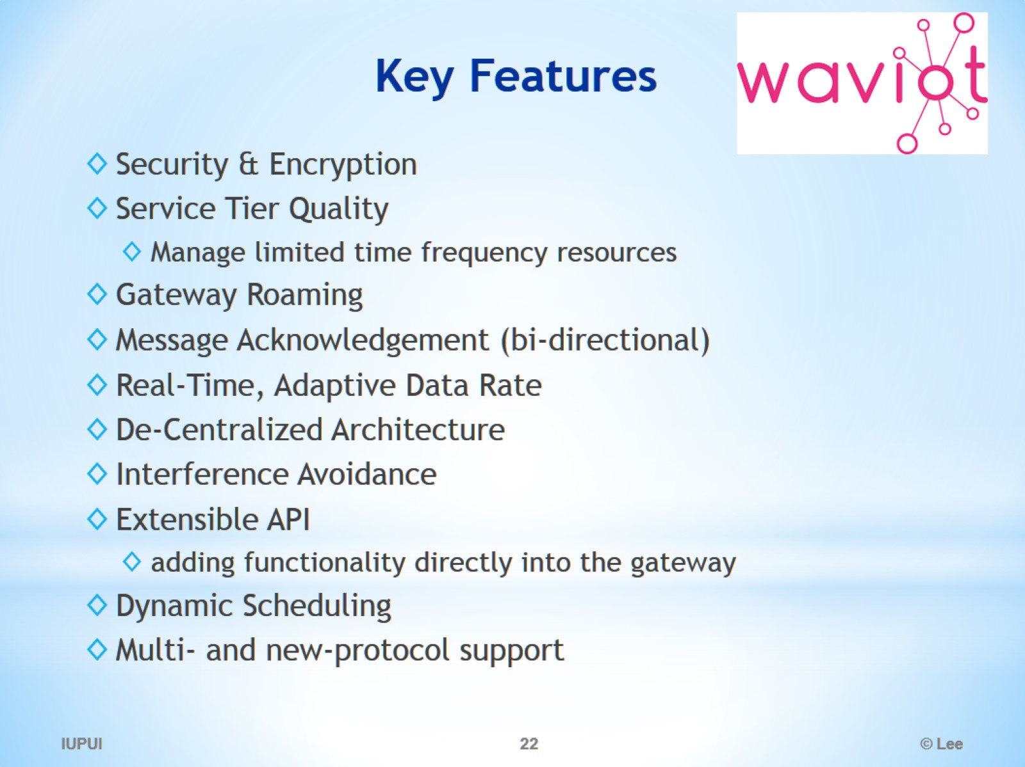
Key Features

Slide 23
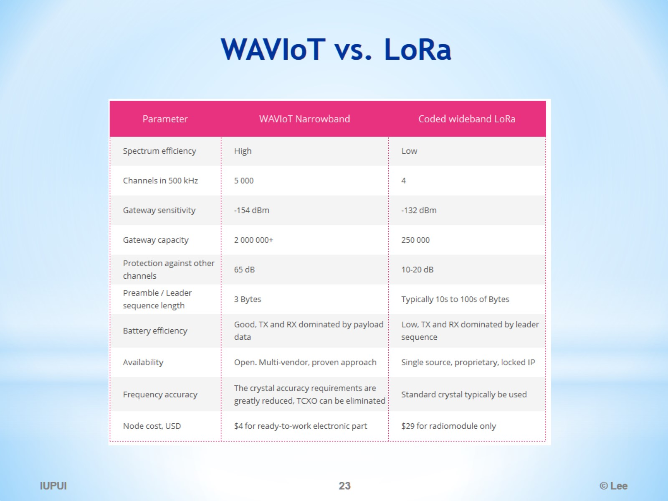
WAVIoT vs. LoRa

Slide 24
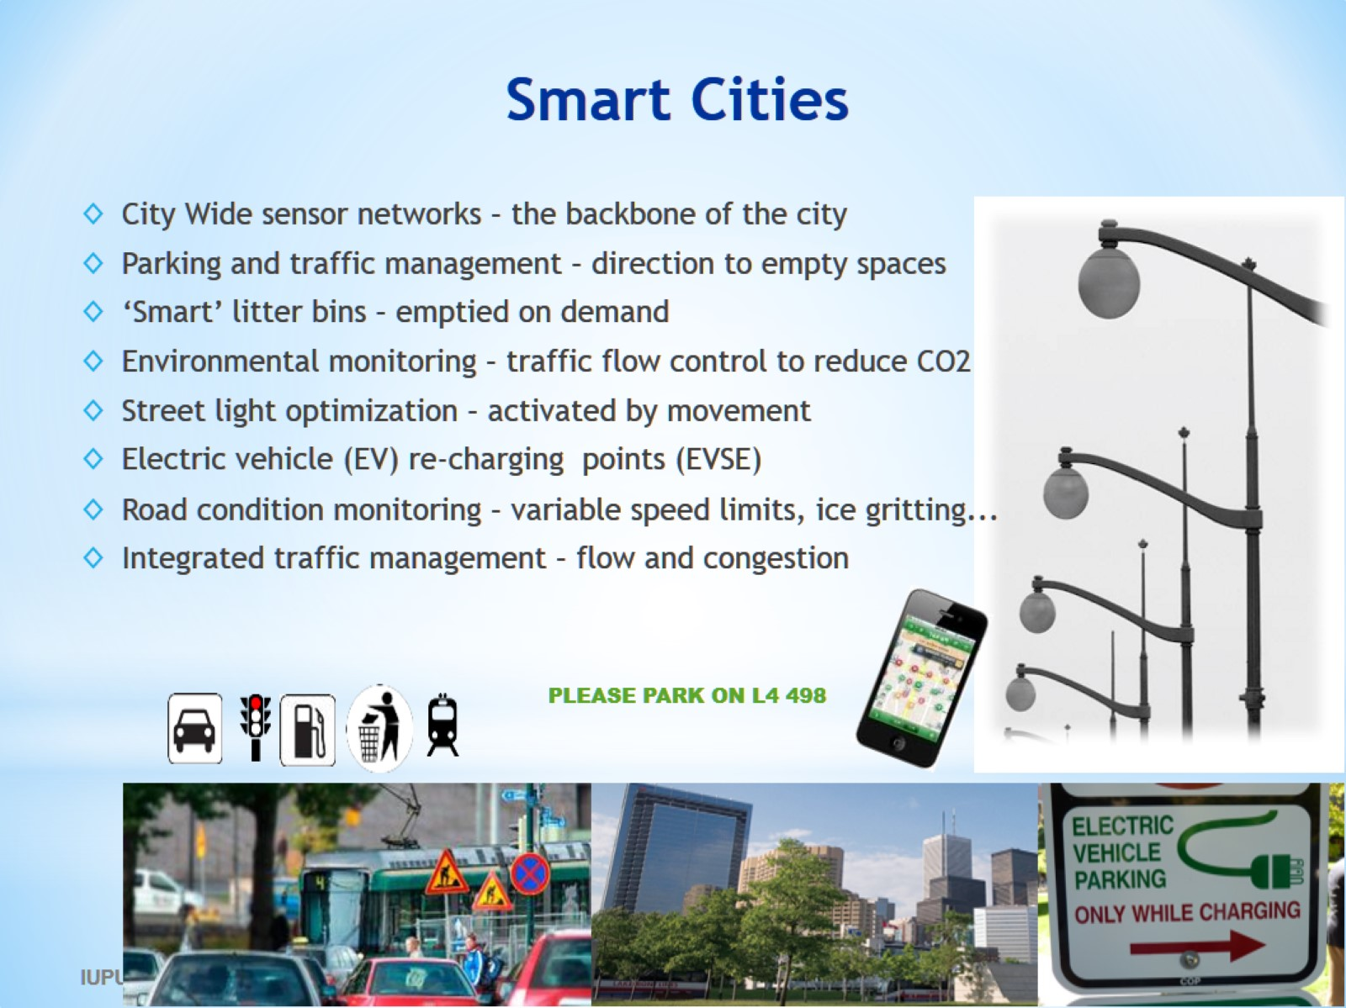
Smart Cities

Slide 25
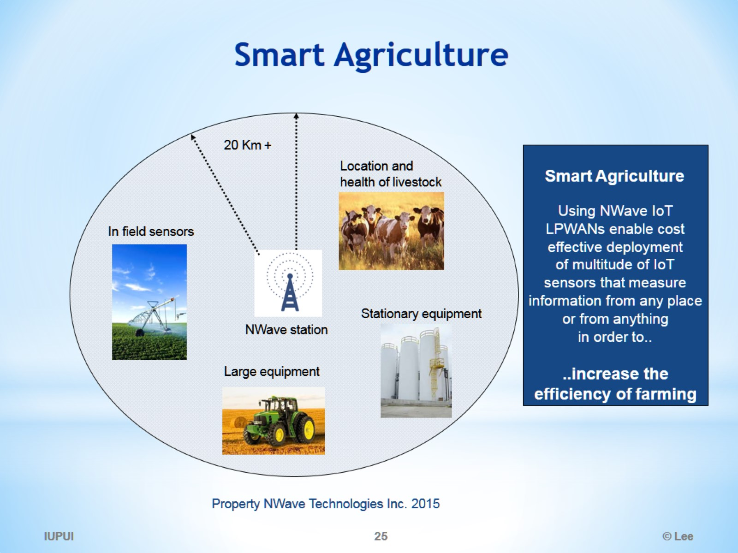
Smart Agriculture

Slide 26
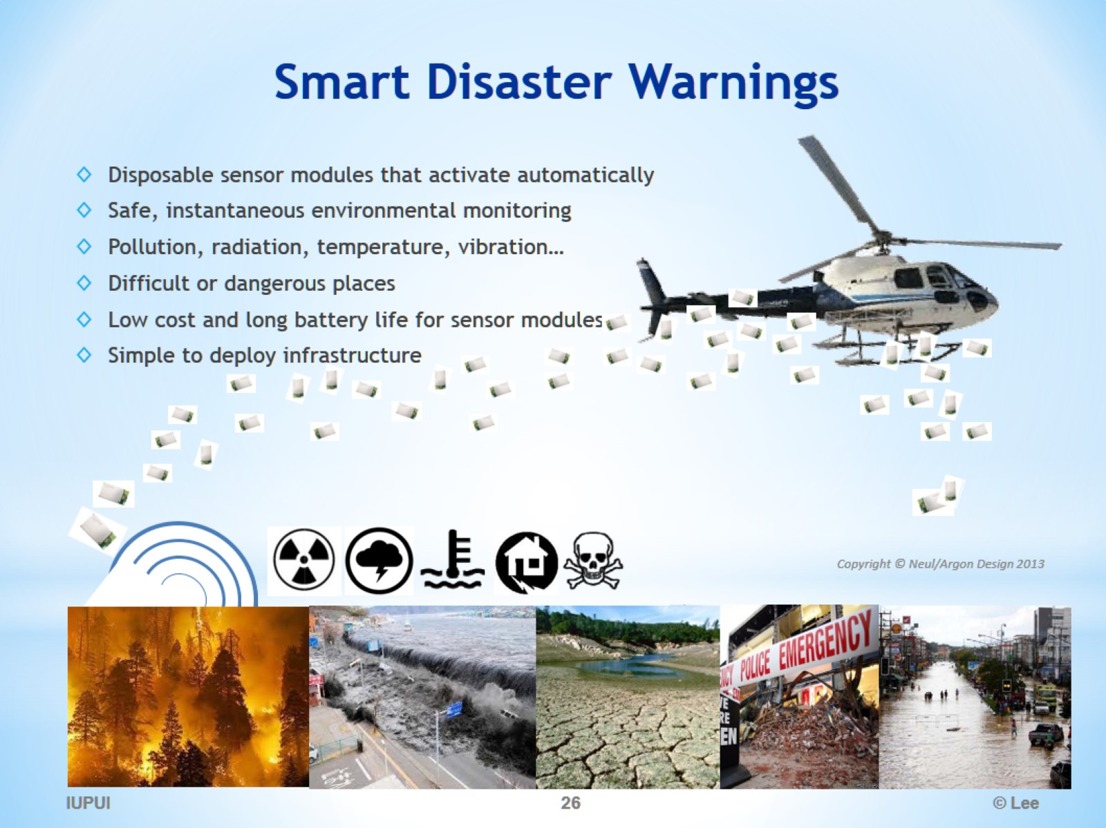
Smart Disaster Warnings

Slide 27
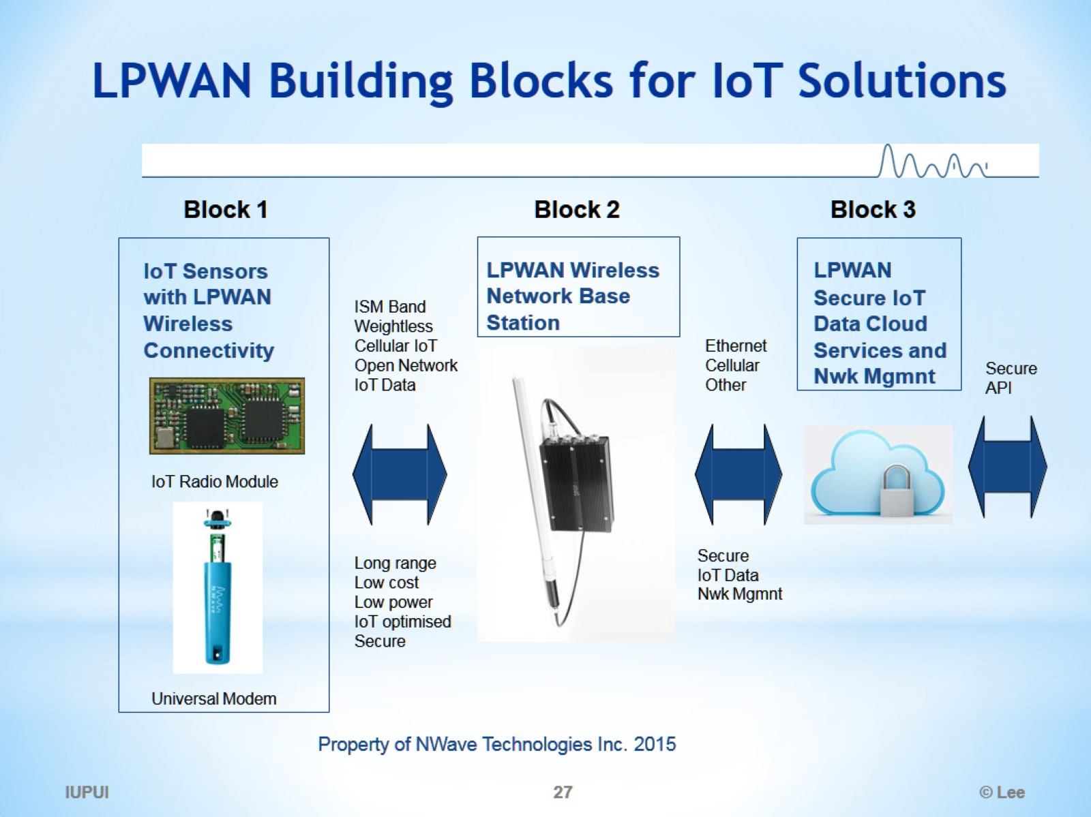
LPWAN Building Blocks for IoT Solutions

Slide 28
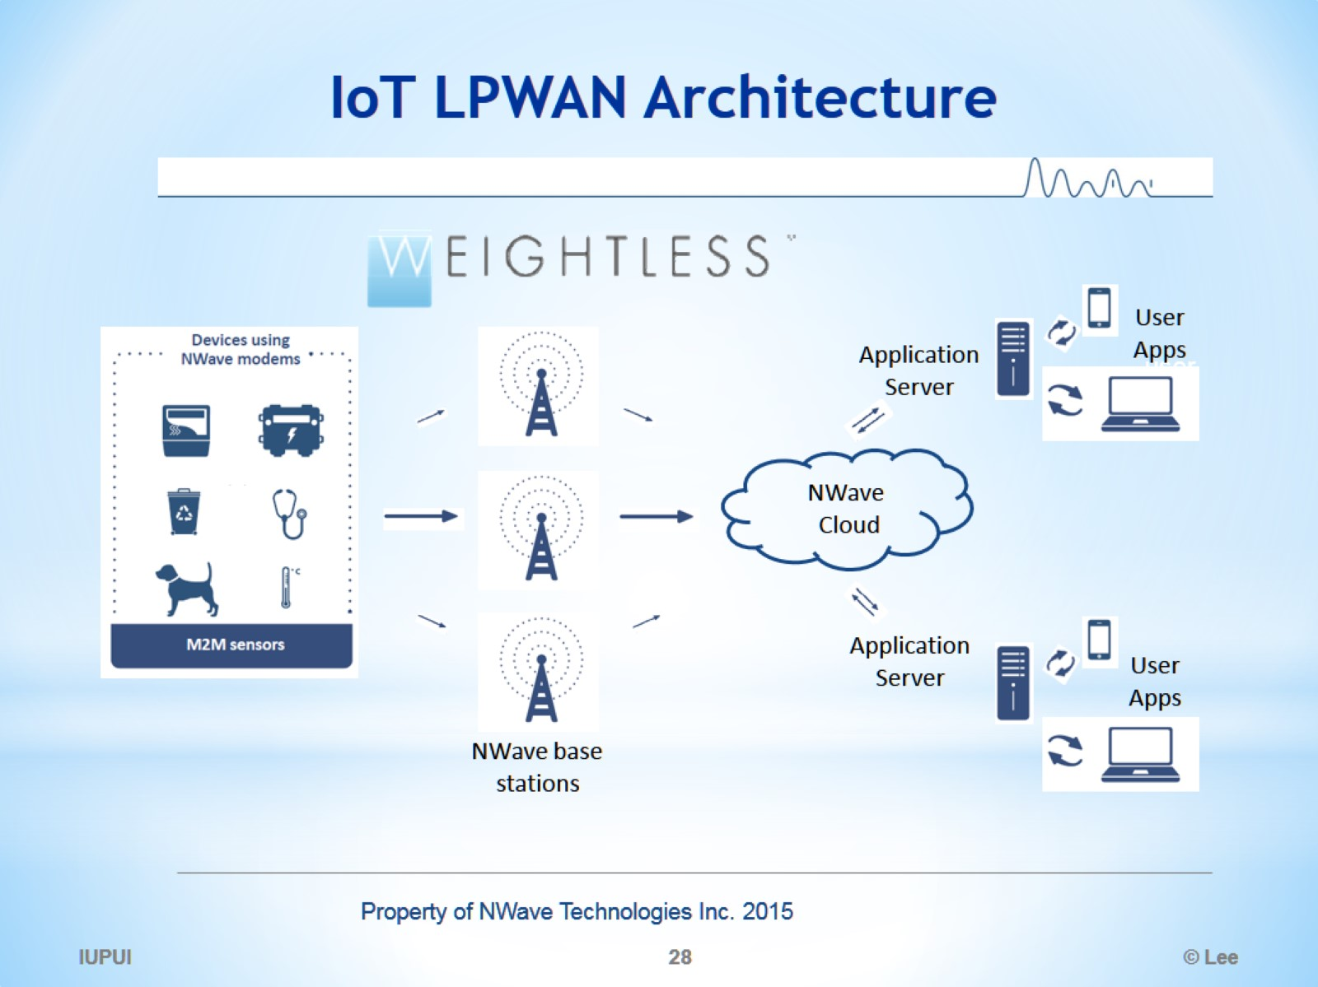
IoT LPWAN Architecture

Slide 29
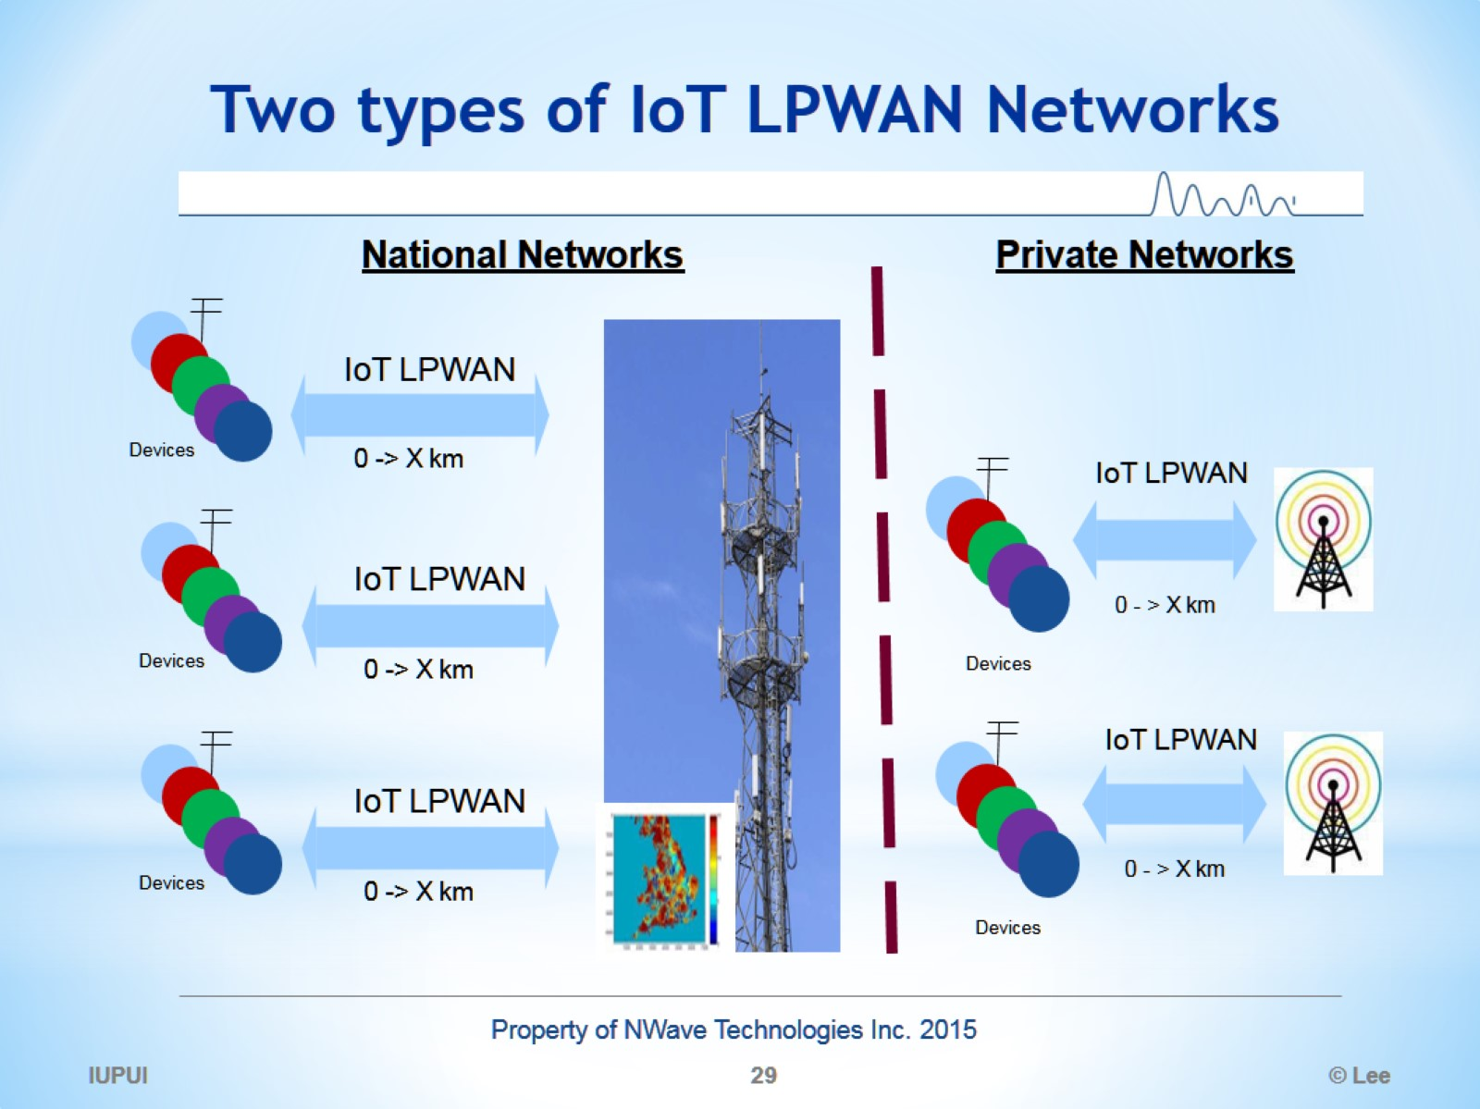
Two types of IoT LPWAN Networks

Slide 30
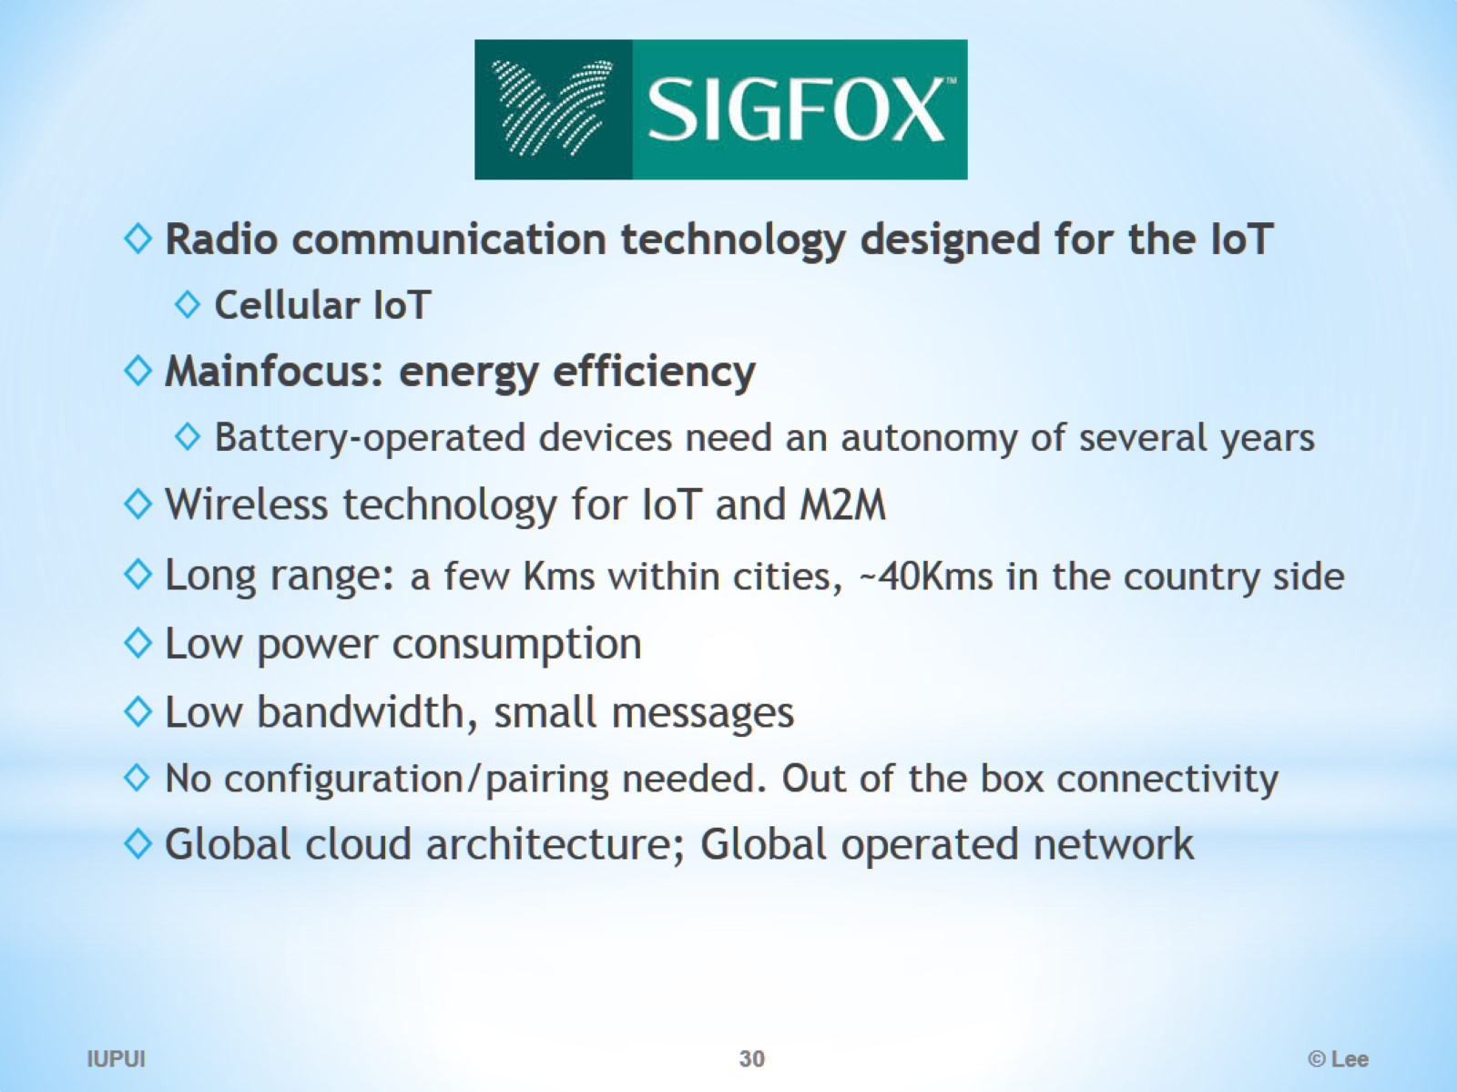
SigFox

Slide 31
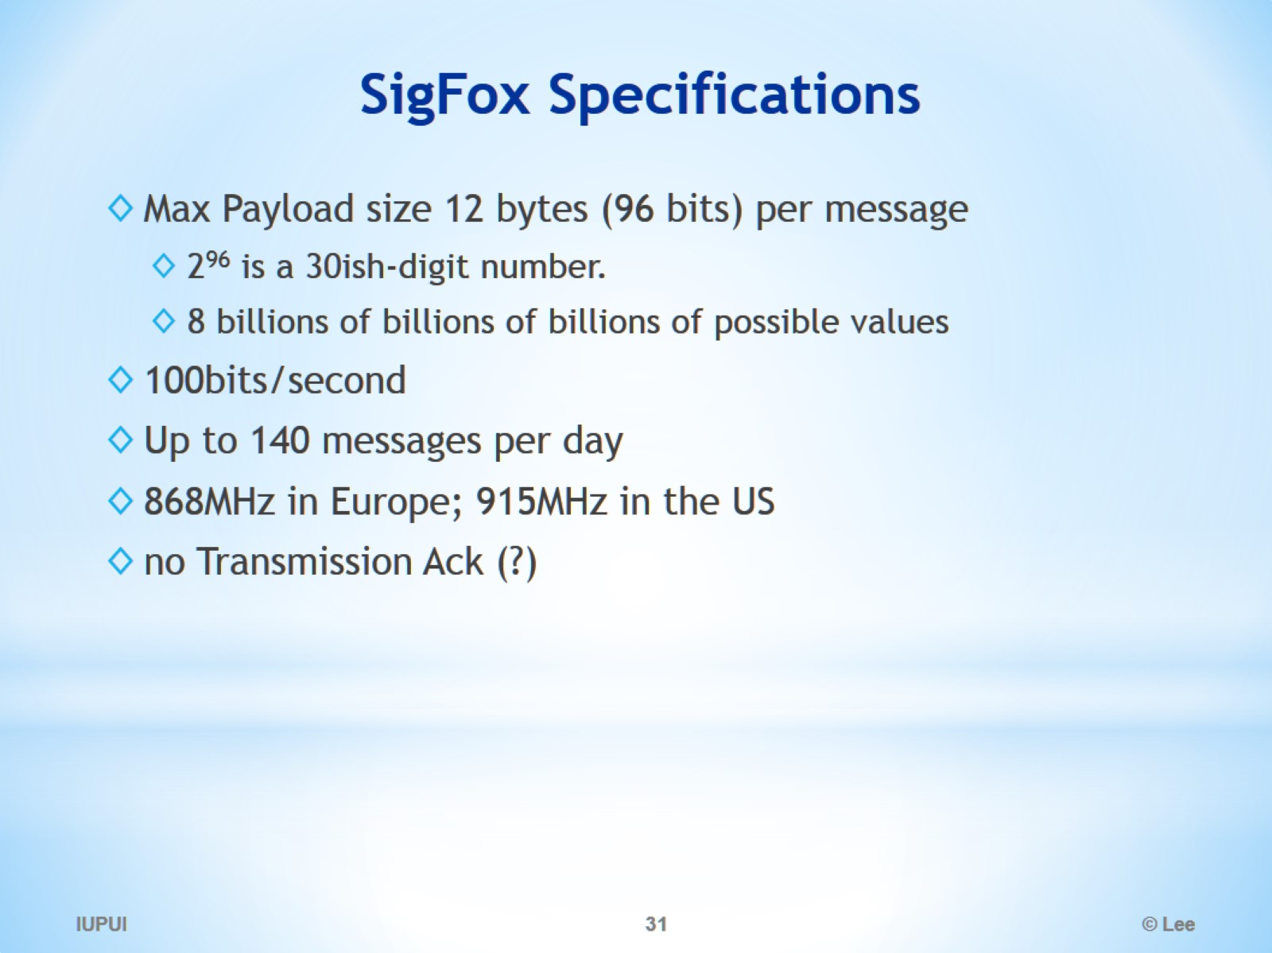
SigFox Specifications

Slide 32
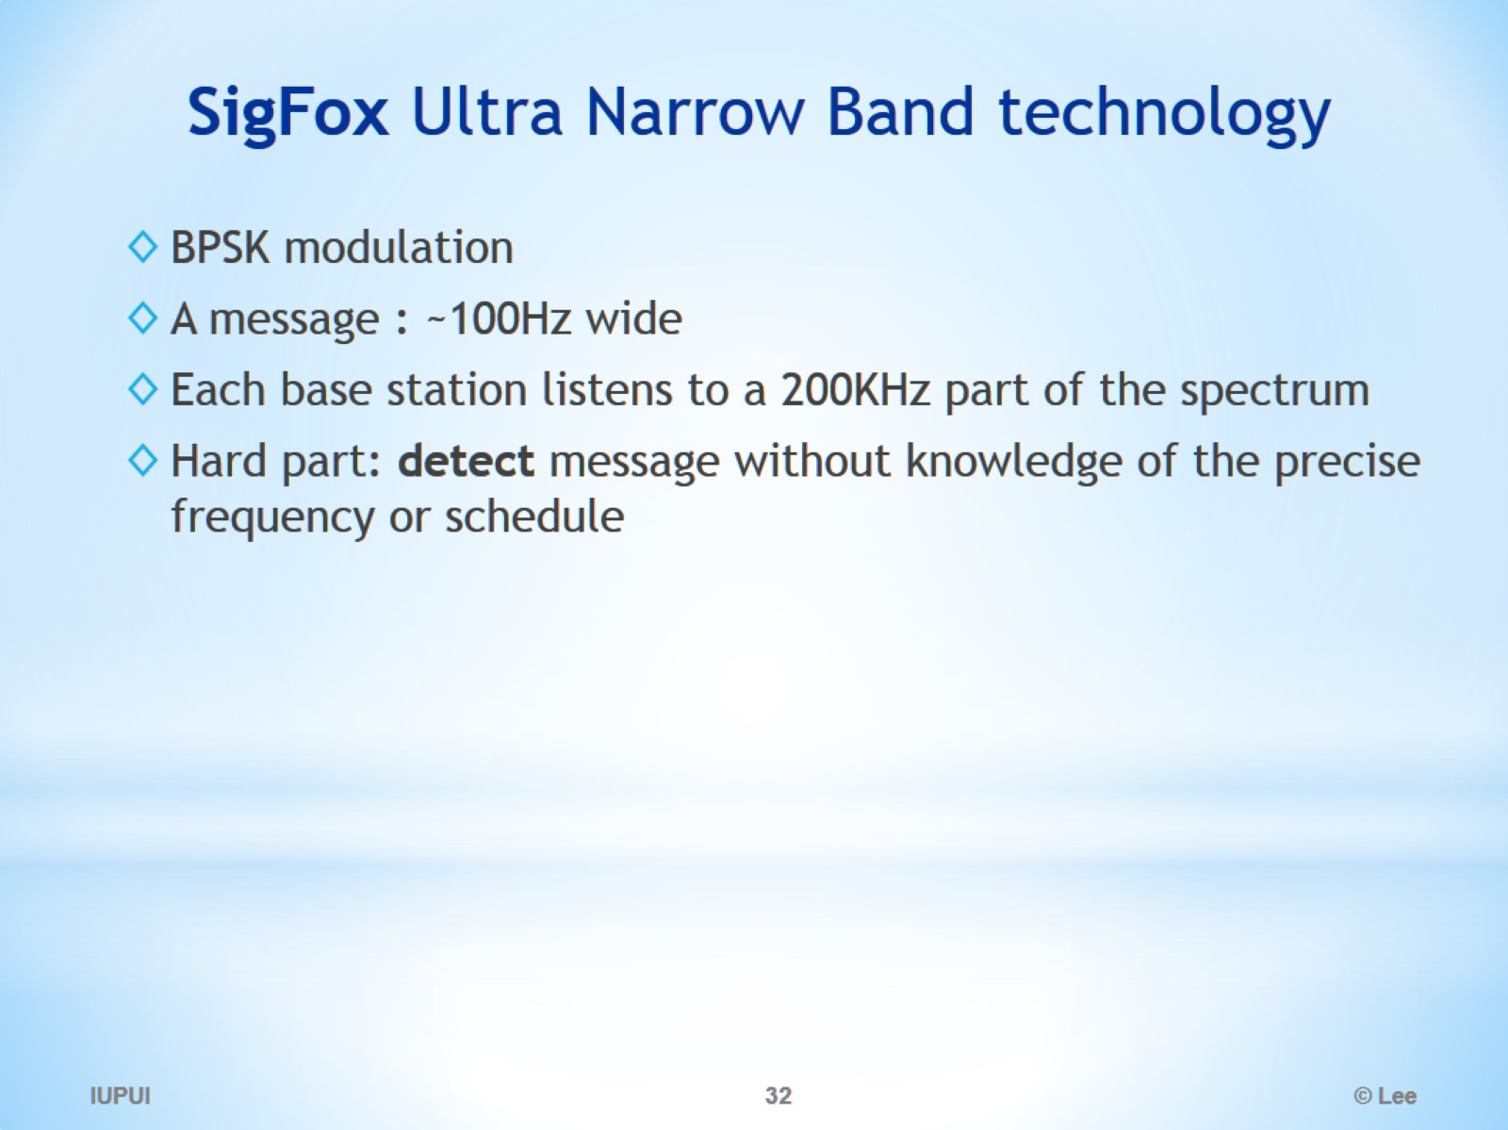
SigFox Ultra Narrow Band technology

Slide 33
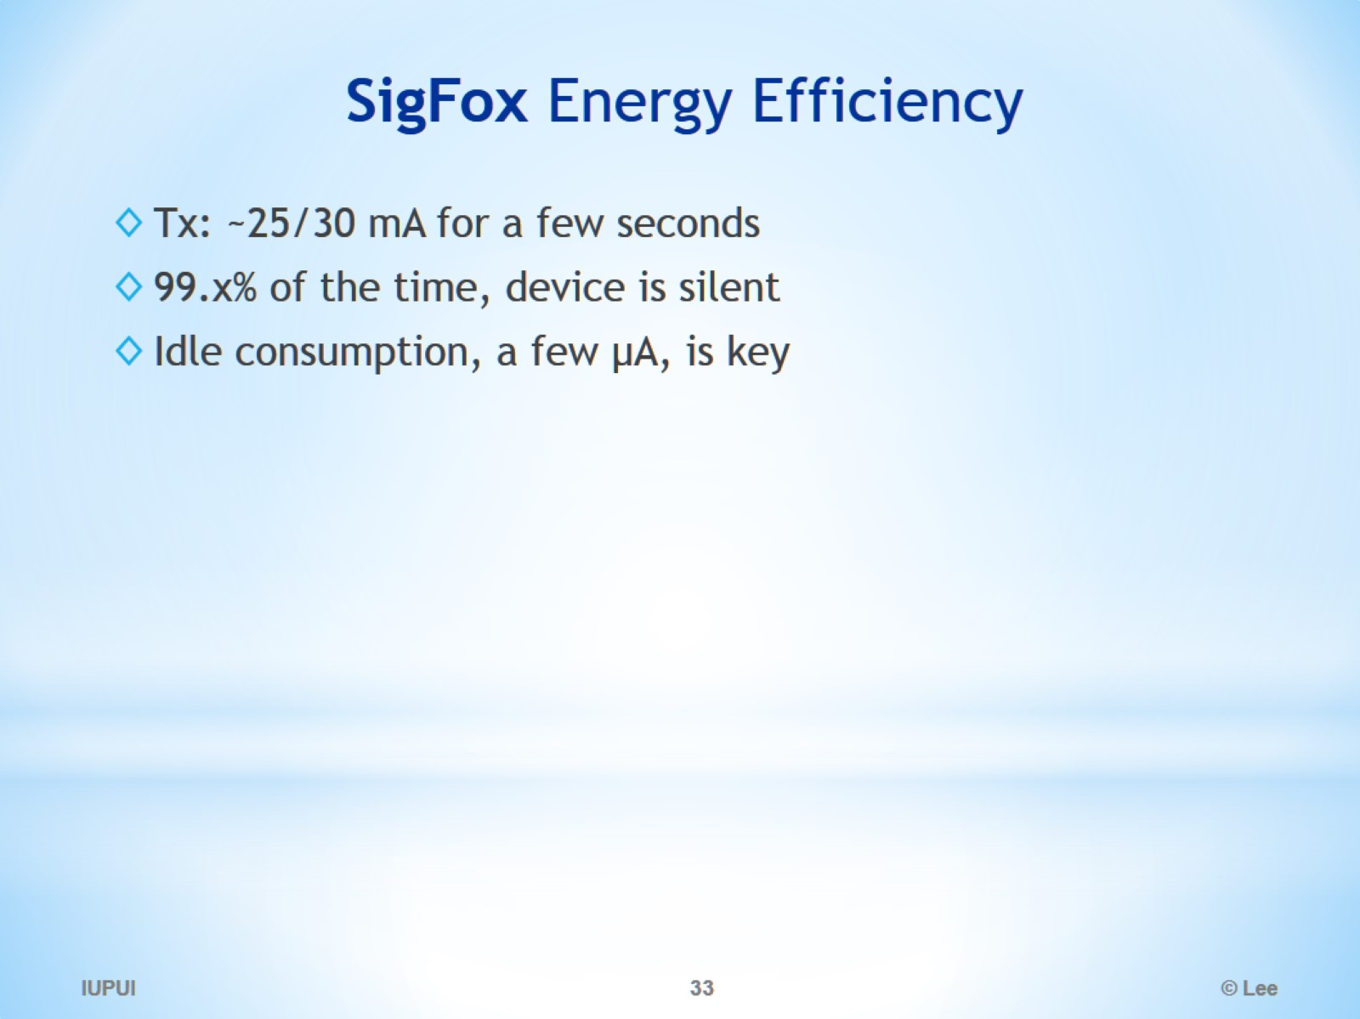
SigFox Energy Efficiency

Slide 34
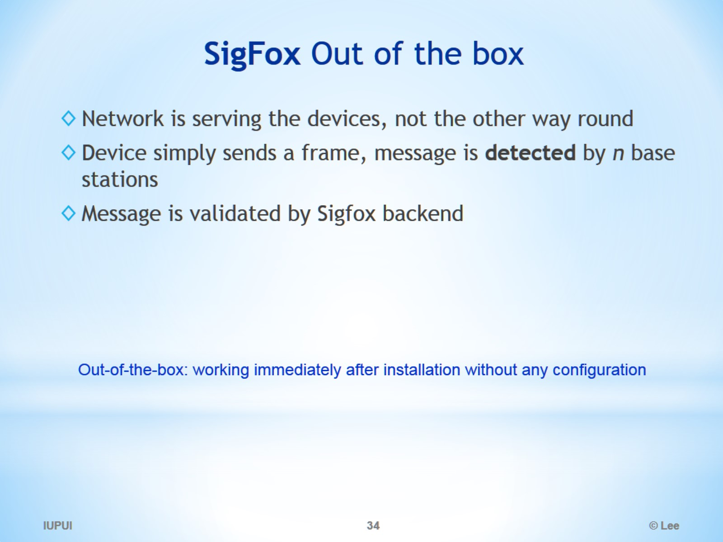
SigFox Out of the box

Slide 35
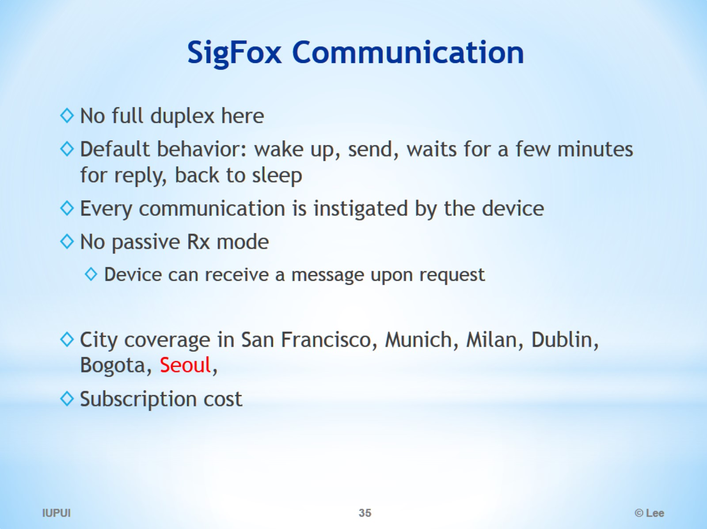
SigFox Communication

Slide 36
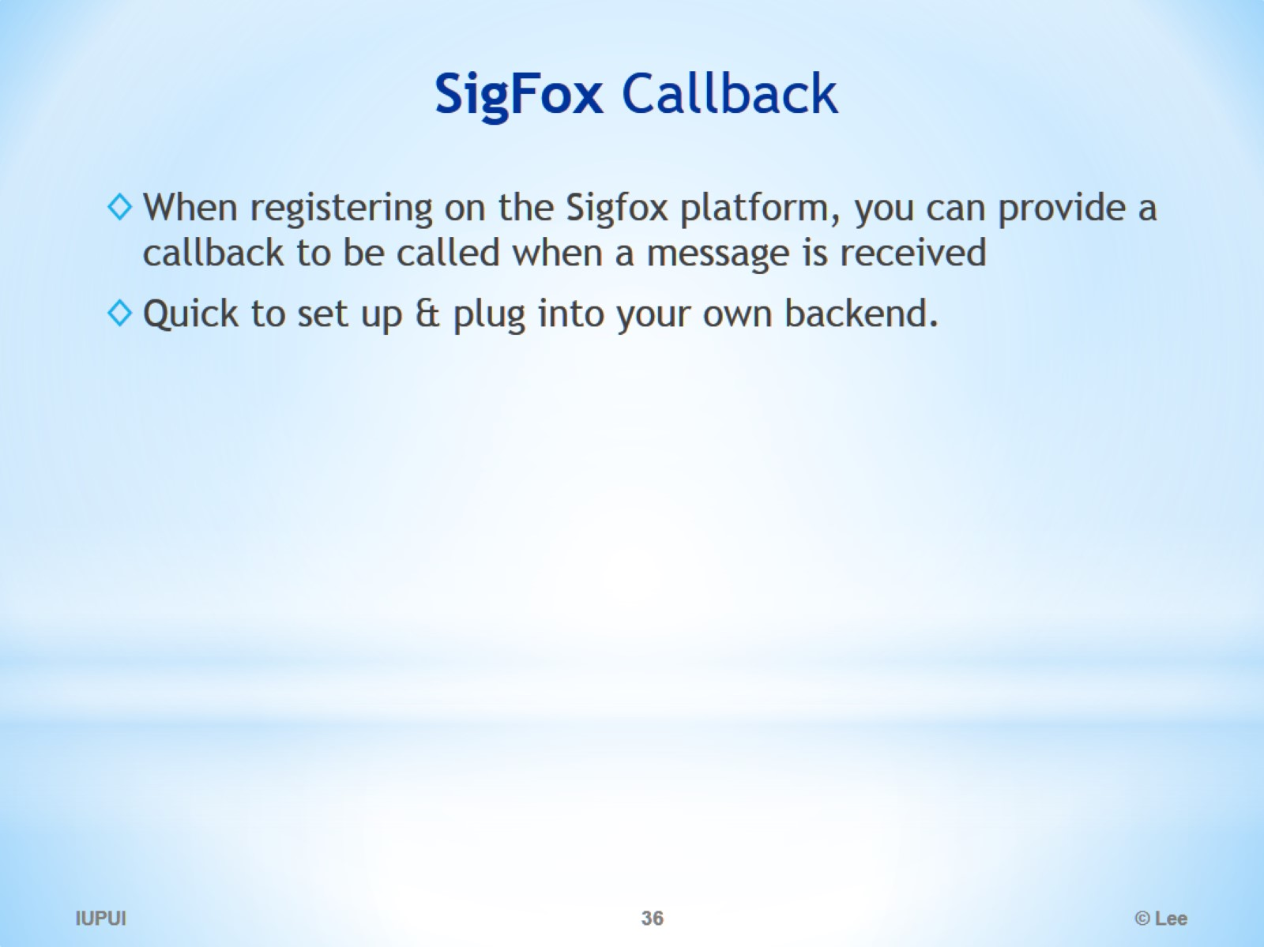
SigFox Callback

Slide 37
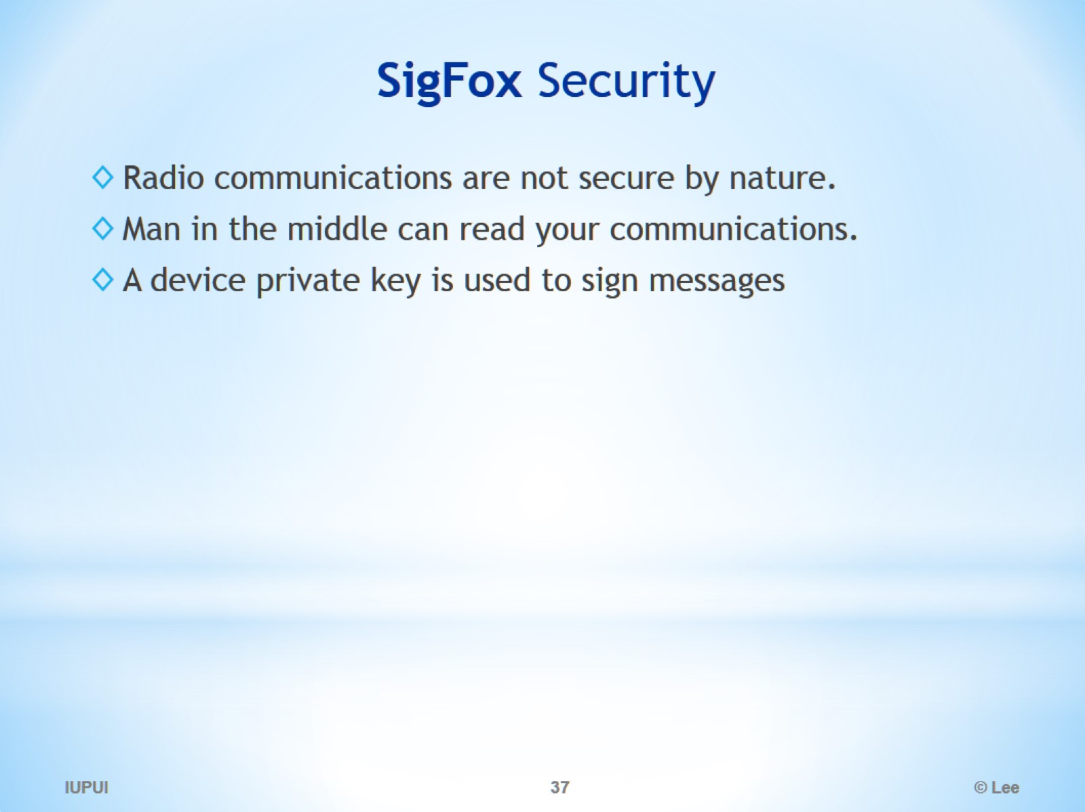
SigFox Security

Slide 38
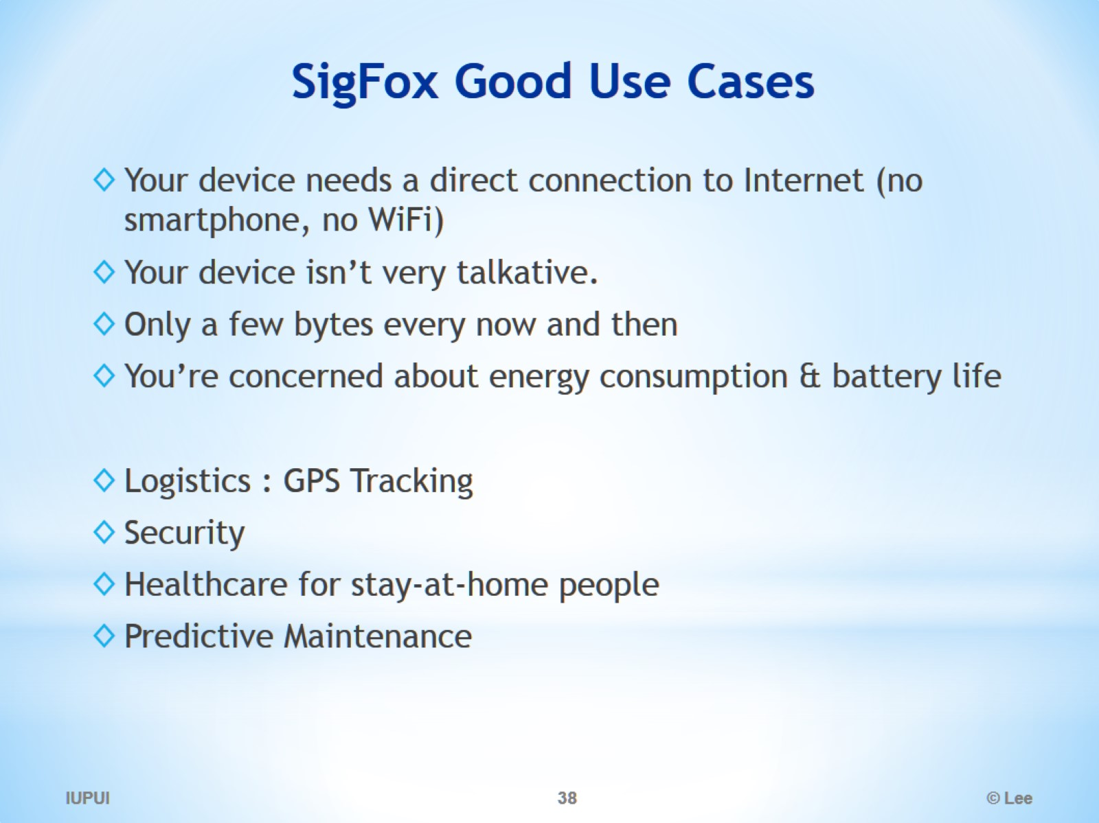
SigFox Good Use Cases

Slide 39
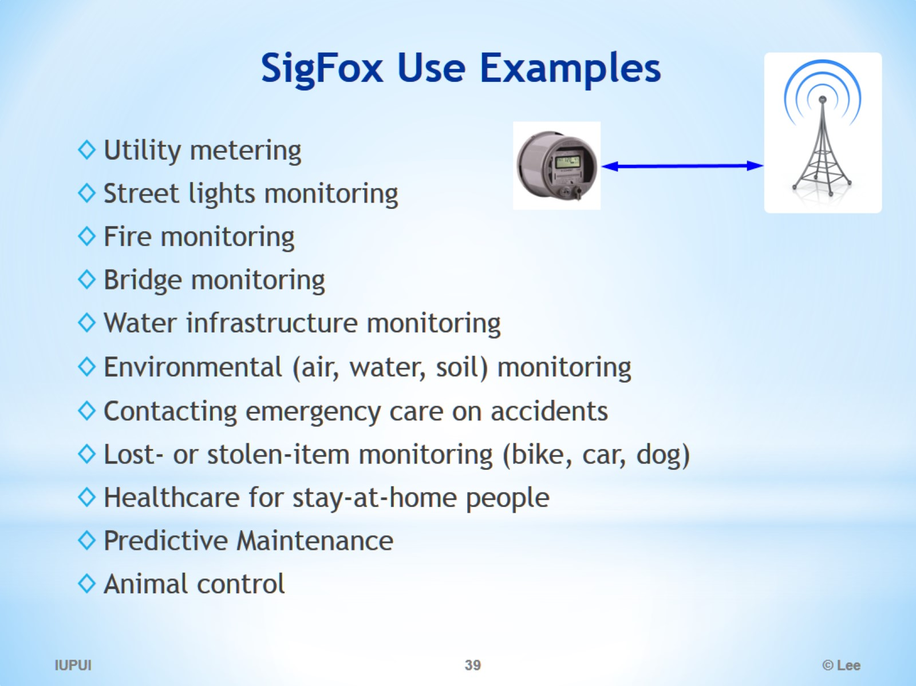
SigFox Use Examples

Slide 40
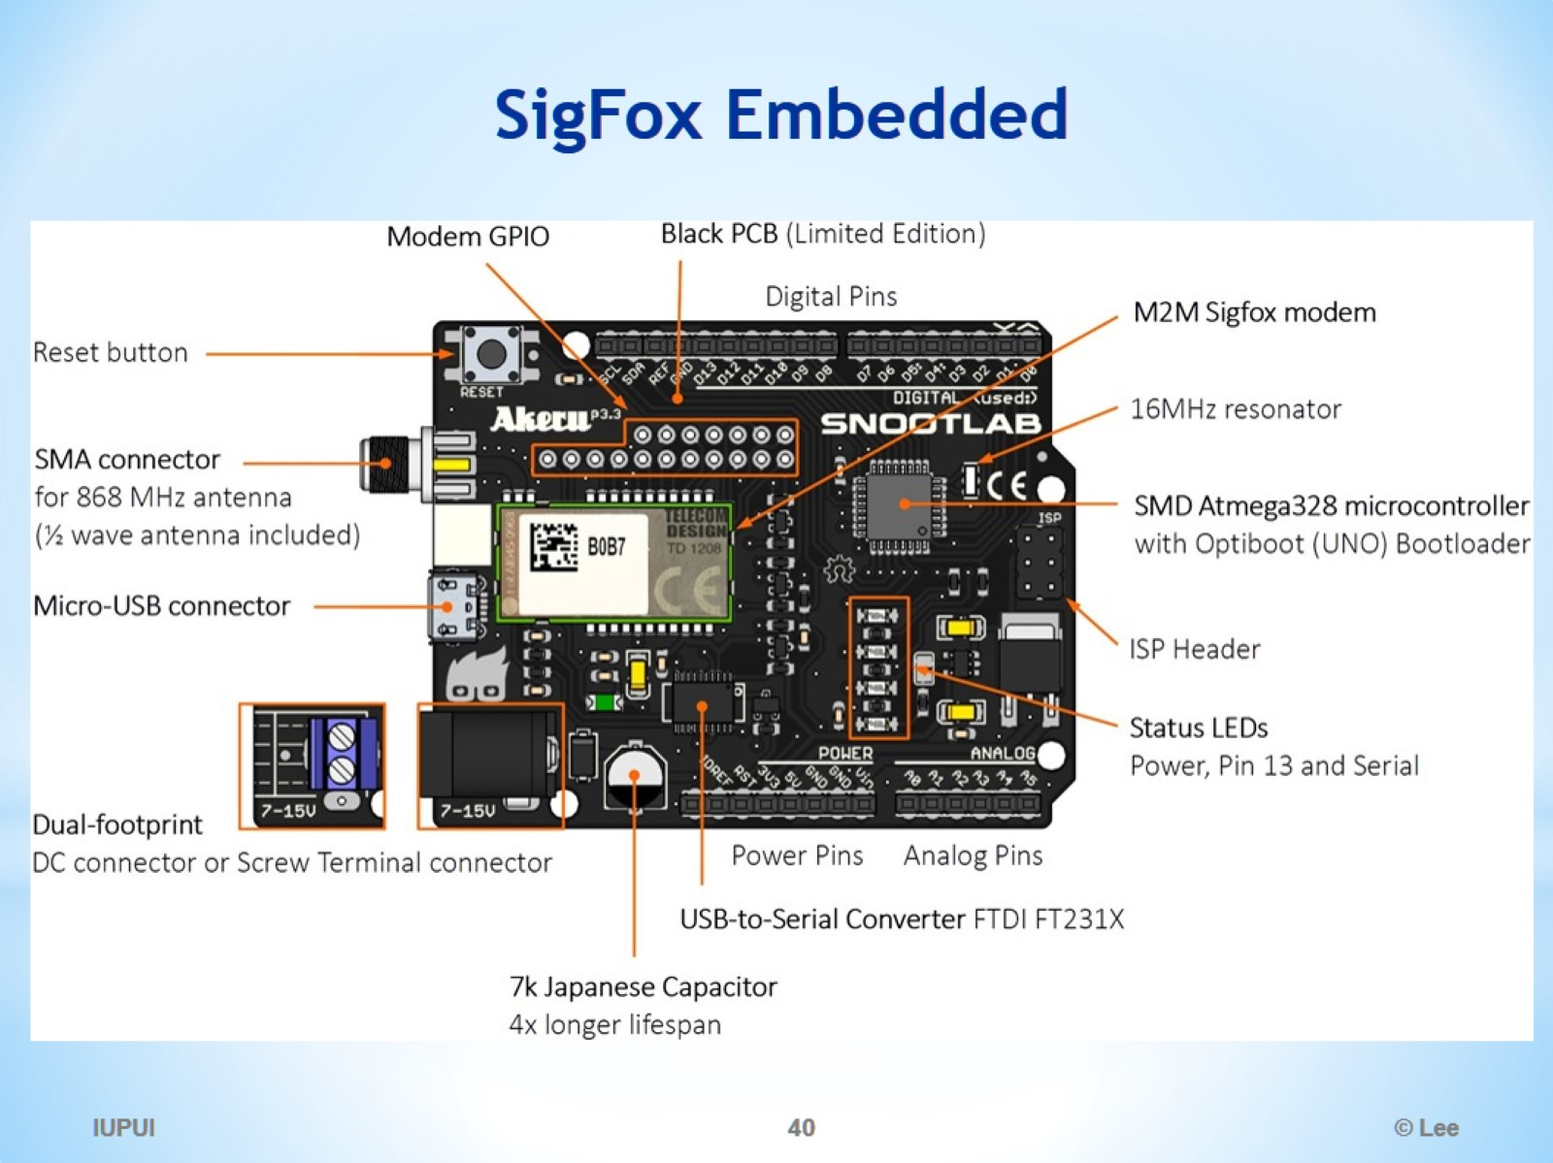
SigFox Embedded

Slide 41
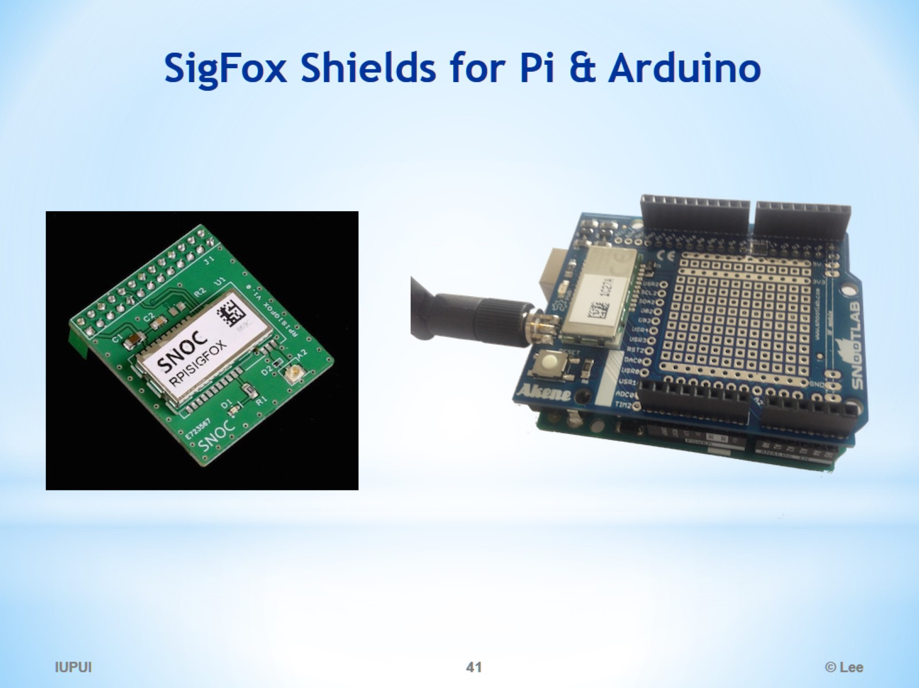
SigFox Shields for Pi & Arduino

Slide 42
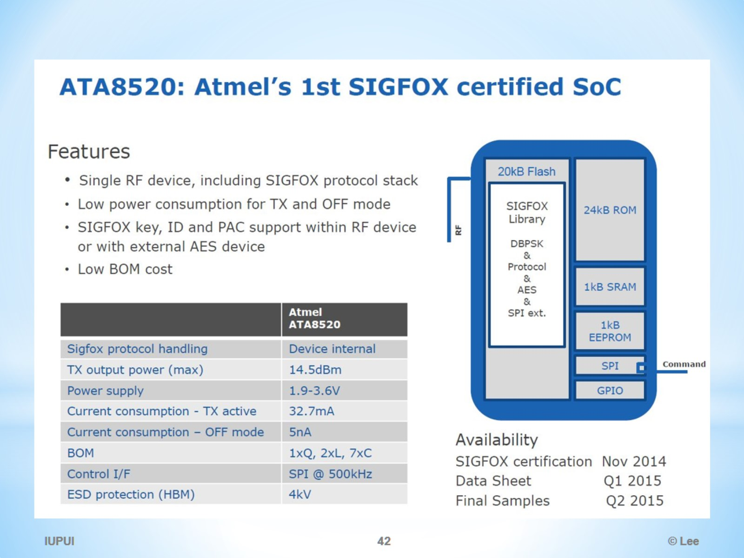

Slide 43
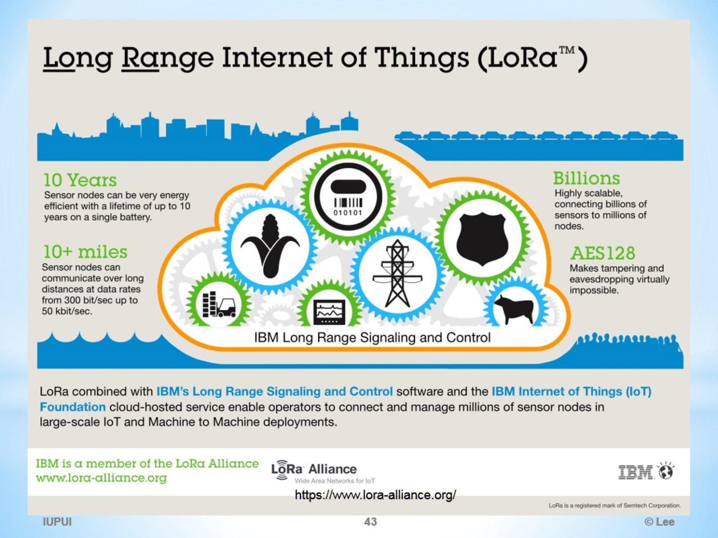

Slide 44
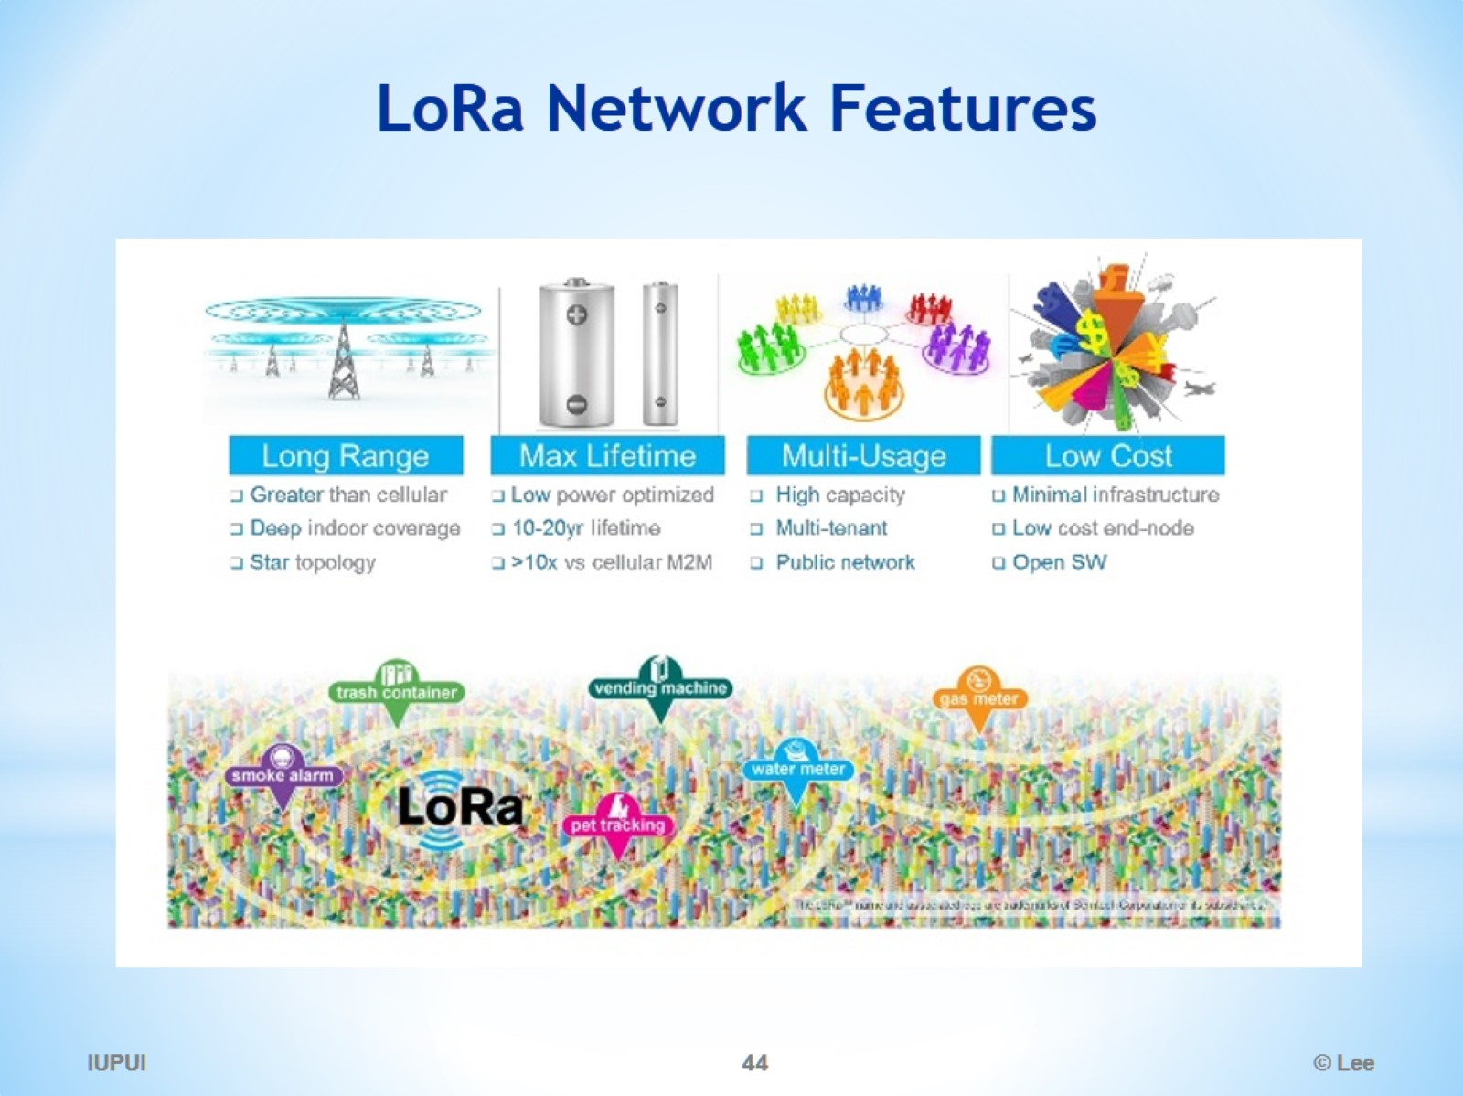
LoRa Network Features

Slide 45
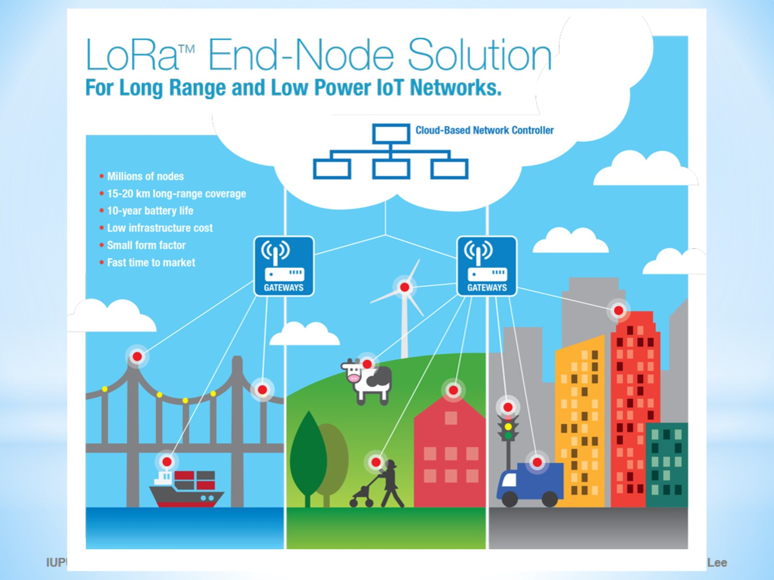

Slide 46
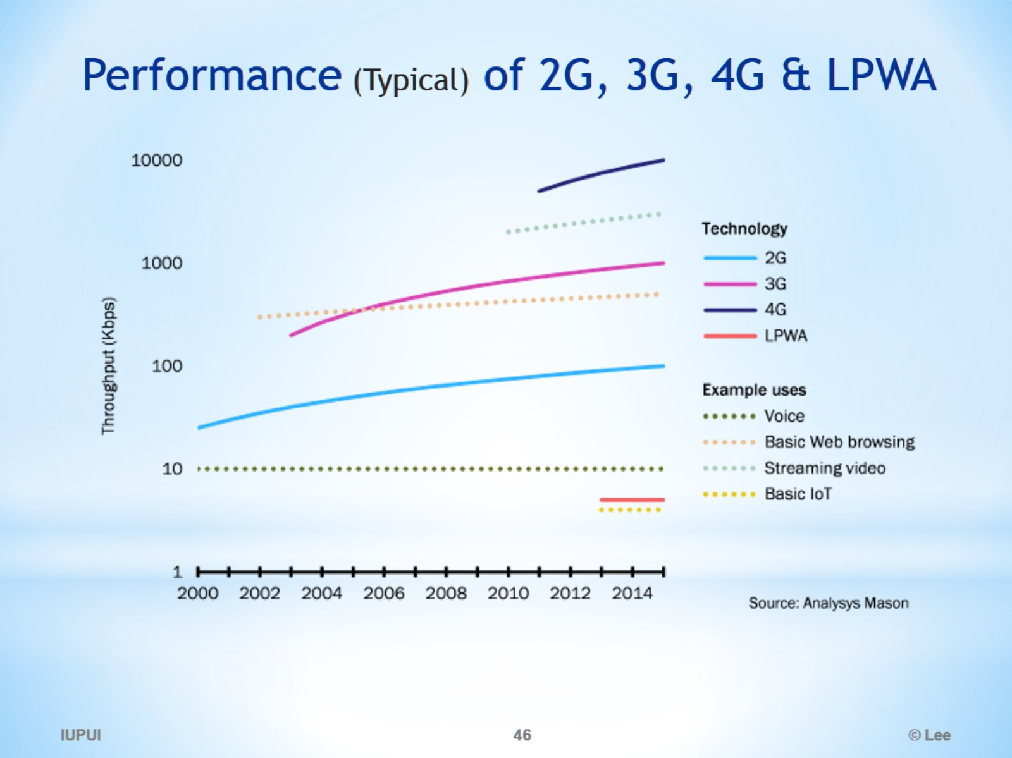
Performance (Typical) of 2G, 3G, 4G & LPWA

Slide 47
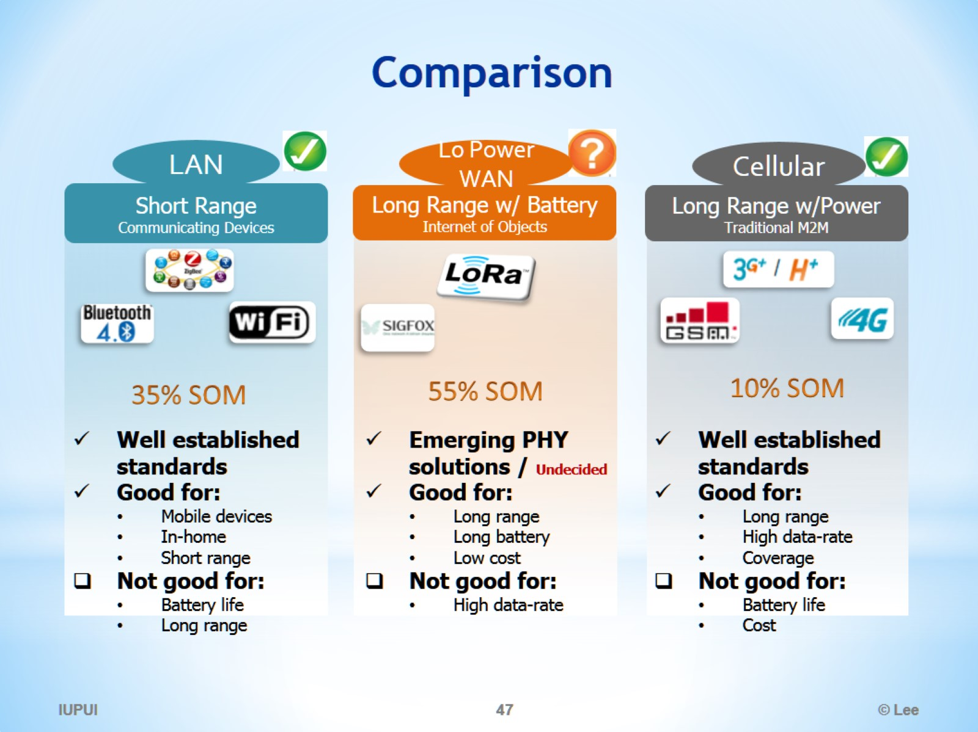
Comparison

Slide 48
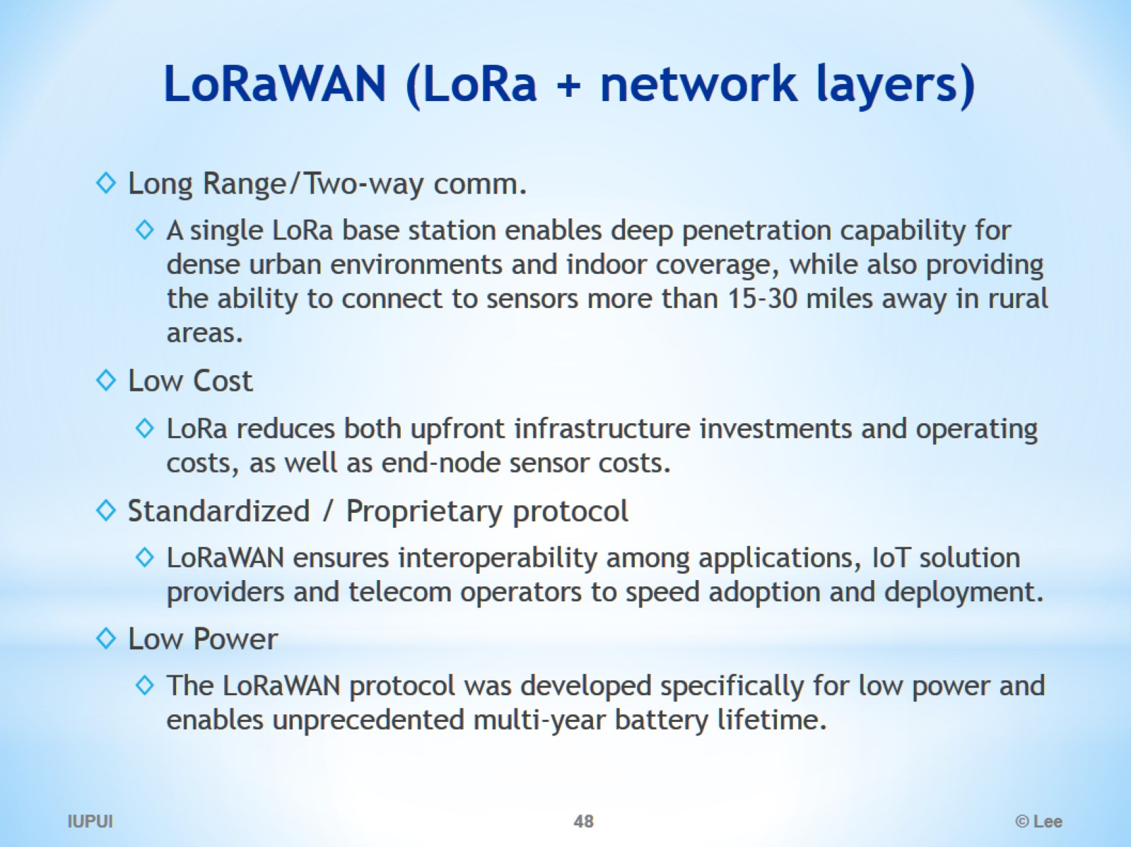
LoRaWAN (LoRa + network layers)

Slide 49
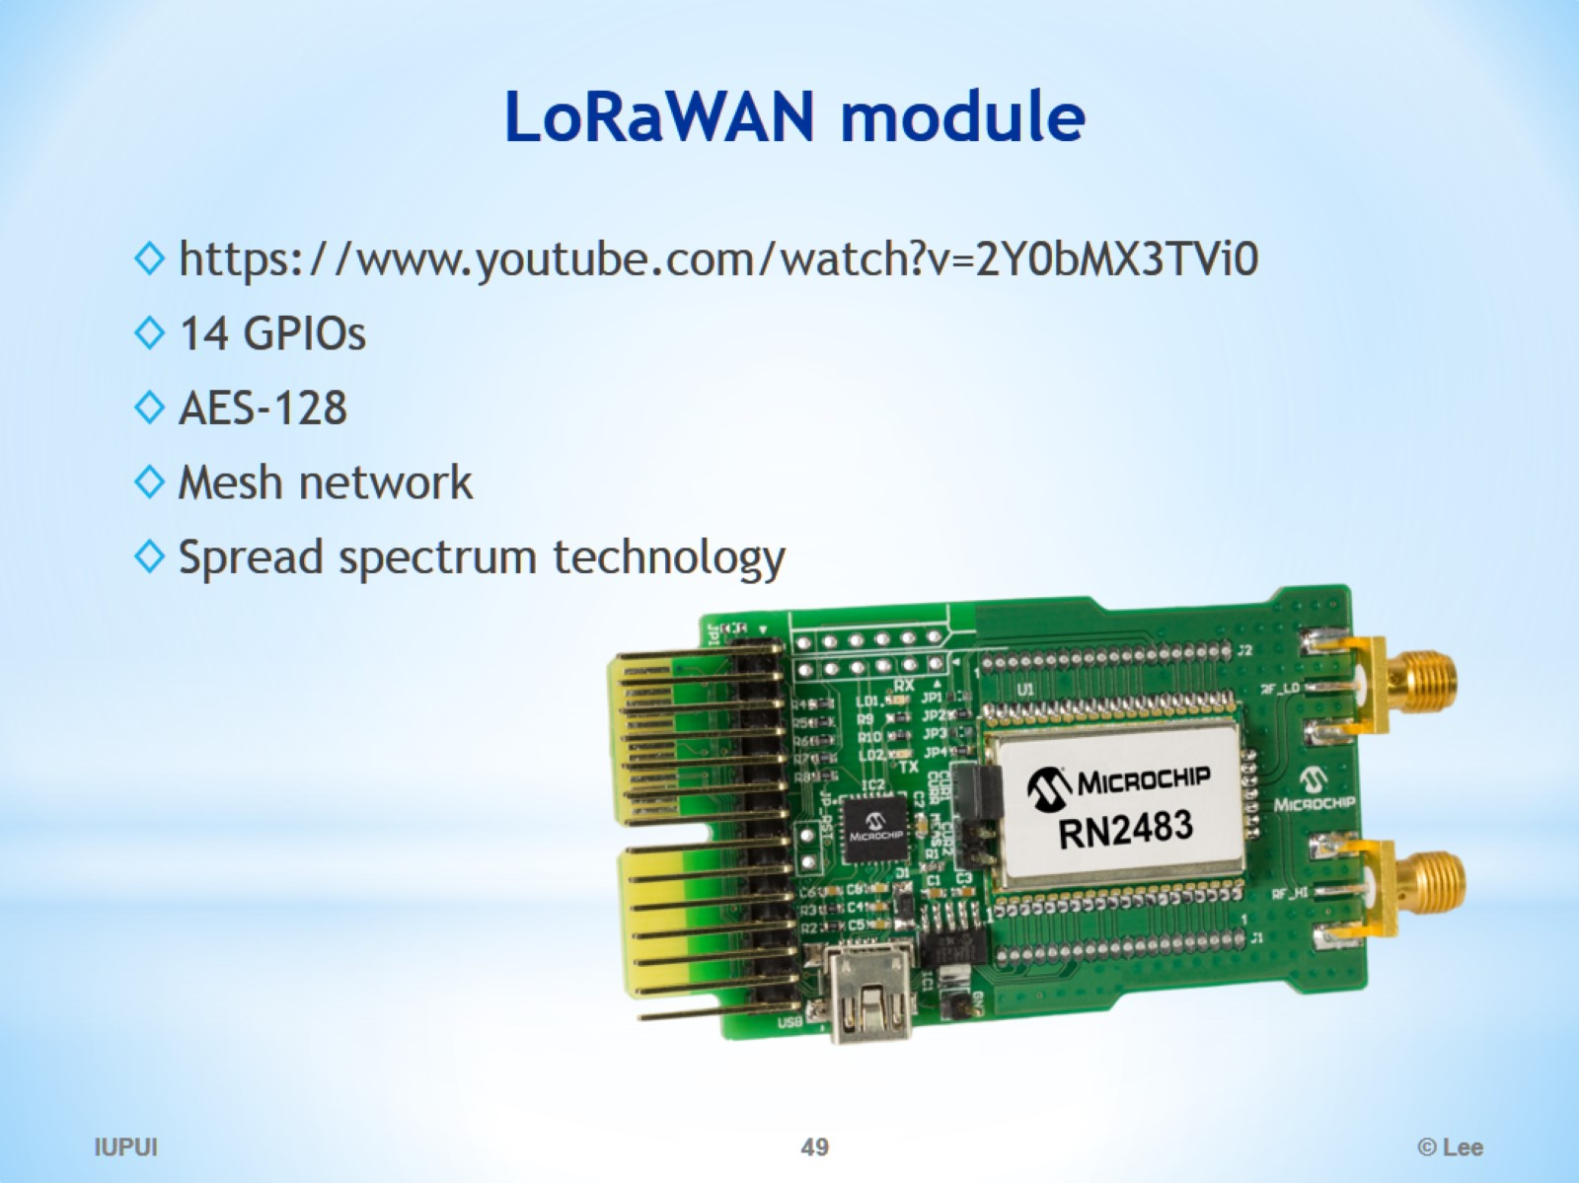
LoRaWAN module

Slide 50
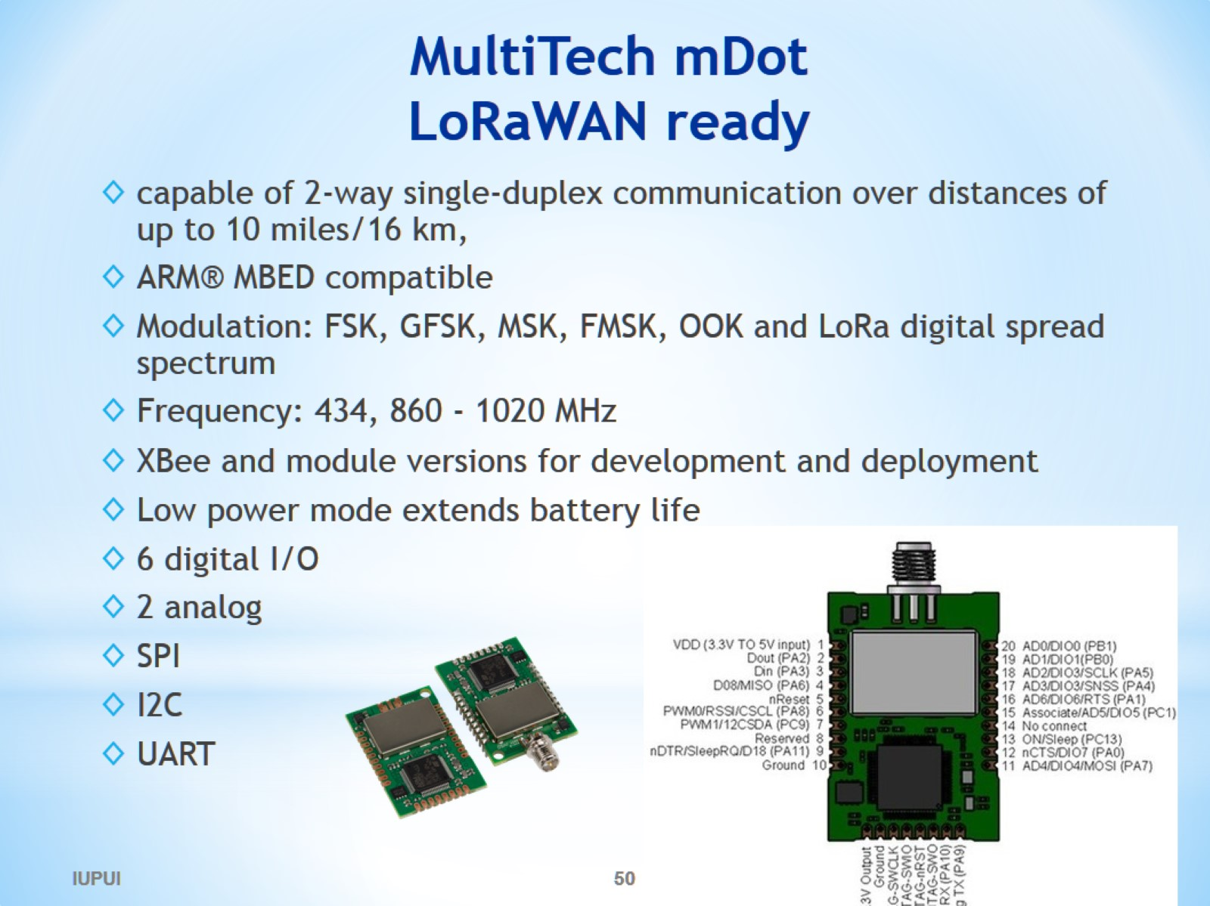
MultiTech mDot LoRaWAN ready

Slide 51

NB-CIoT vs NB-LTE

Slide 52

NB-CIoT vs NB-LTE

Slide 53

NB-LTE Supporting Members

Slide 54

Comparison of LPWAN

Slide 55


Slide 56

The Things Network (based on LoRaWAN)

Slide 57

The Things Network

Slide 58

The Things Network

Slide 59

The Things Network

Slide 60

The Things Network

Slide 61

The Things Network

Slide 62

Frequency

Slide 63

Data Rate

Slide 64

Range

Slide 65

Energy (Power) Consumption

Slide 66

World’s largest IoT network in India

Slide 67

Tata Communications building world’s largest IoT network in India

